Slide 1
DO YOUR OWN GARDEN!!!!!
GROW YOUR ORGANIC GREENS, VEGGIES & Herbs

Slide 2
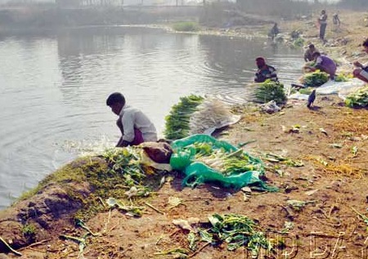
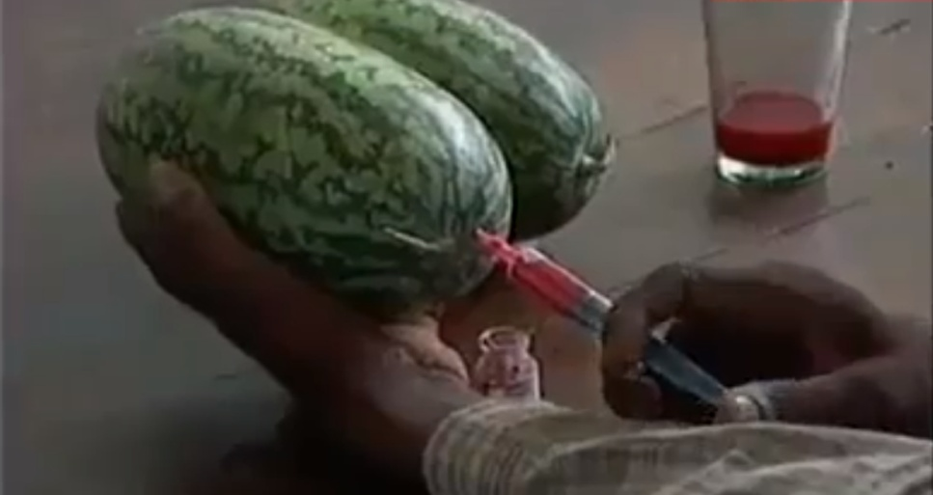
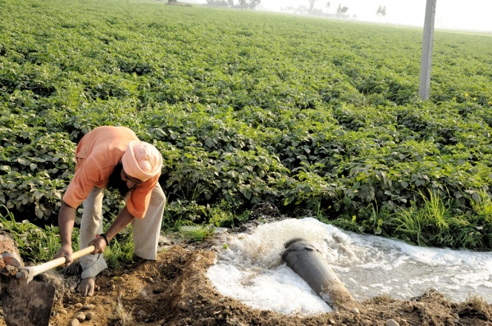
WHAT DO YOU CONSUME TODAY ?
Greens that are grown in sewage water.
Chemical fertilized and pesticides vegetables
& greens.
Chemical injected fruits.
Graphite stone fruits.

Slide 3
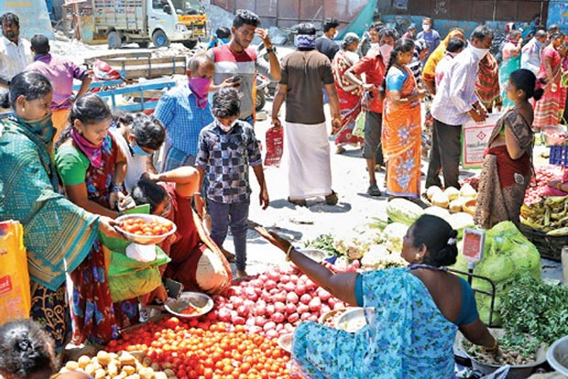
IS IT SAFE TO GET VEGETABLES IN THIS PLACES TODAY ?
In this Pandemic situation, we can’t get
veggies from outside.
It is possible to get the virus infection
from these
Crowded places
Like Koyambedu
Market.

Slide 4
HOW TO RUN AWAY FROM ALL THESE DANGERS?
Build your own ORGANIC SAFE GARDEN
Be satisfied with what you eat
Get fresh Greens/Veggies /Fruits from your Organic Garden
Control your diseases like cold, fever, kidney stone, diabetes etc by having Herbs

Slide 5
SOLUTION ?
Here we are!!!
Assist you
Help you
Support you
Technically guide you
Till you need

Slide 6
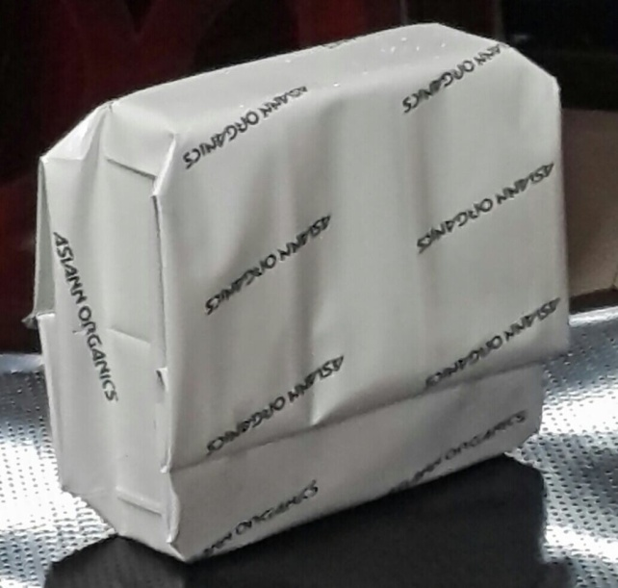
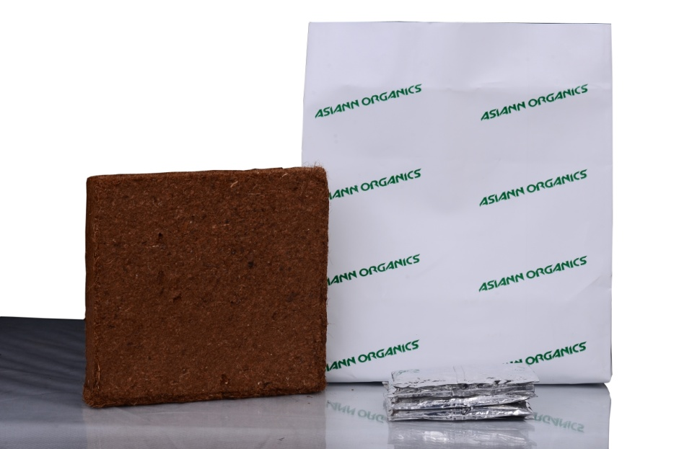
OUR PRODUCT
Grow Kits
  UV treated grow bag in various sizes for greens/veggies/fruits
  Coco peat block – organic soil-less
  growing medium
  Organic seaweed fertilizers
  Seeds/Saplings
Organic Fertilizer – Veg Booster,
Organic Stimulant
Organic Pesticide - Eco Shield
Potting Soil, Green House

Slide 7
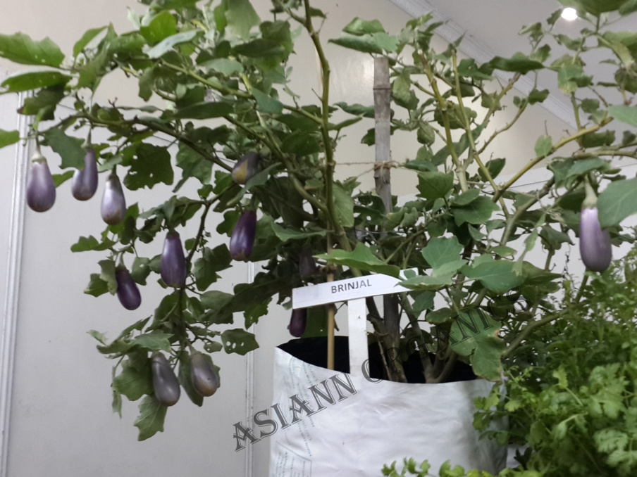
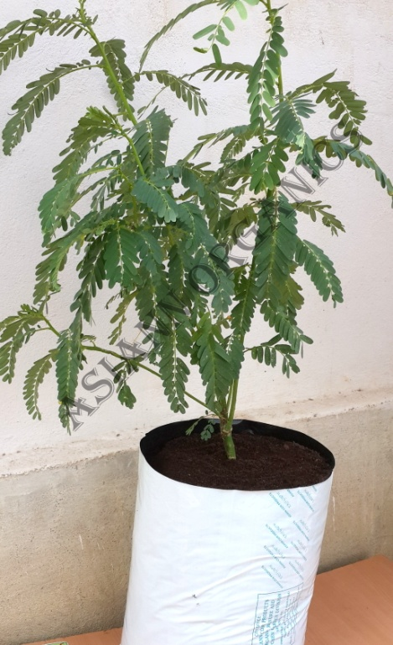
GROW KITS
Easy Grow Kits – Suitable for small plants like tomato, brinjal, coriander, palak, mint etc
Jumbo Easy Grow Kits – Suitable for creepers and medium tree plants like bitter gourd, ridge gourd, curry leaves, drum stick etc

Slide 8
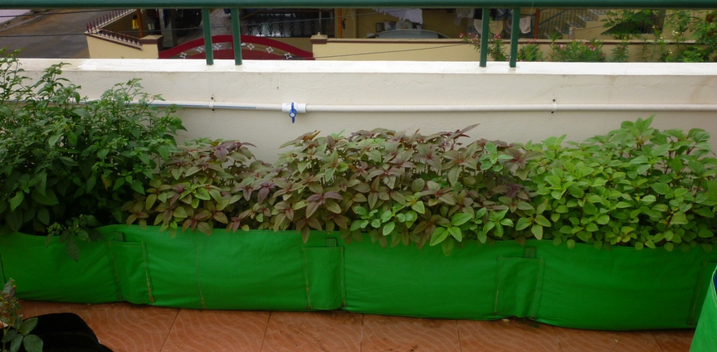
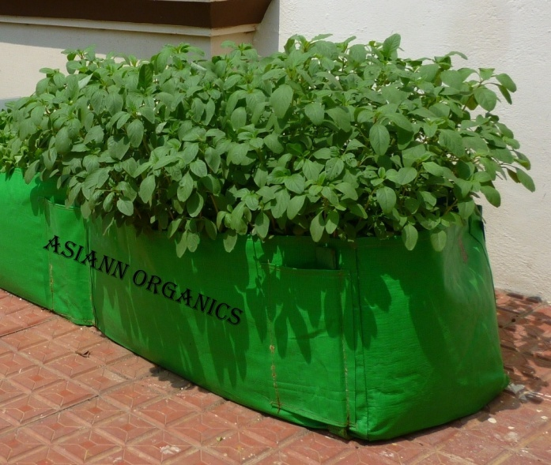
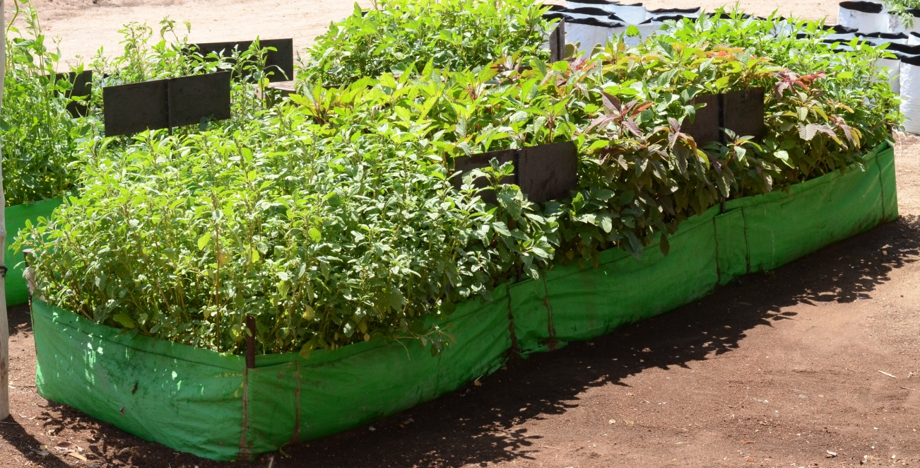
GROW KITS
Greens Ground Kits – 3 types - Suitable for 5 varieties
10’x1’x1’
5’x1’x1’
10’x2’x1’

Slide 9
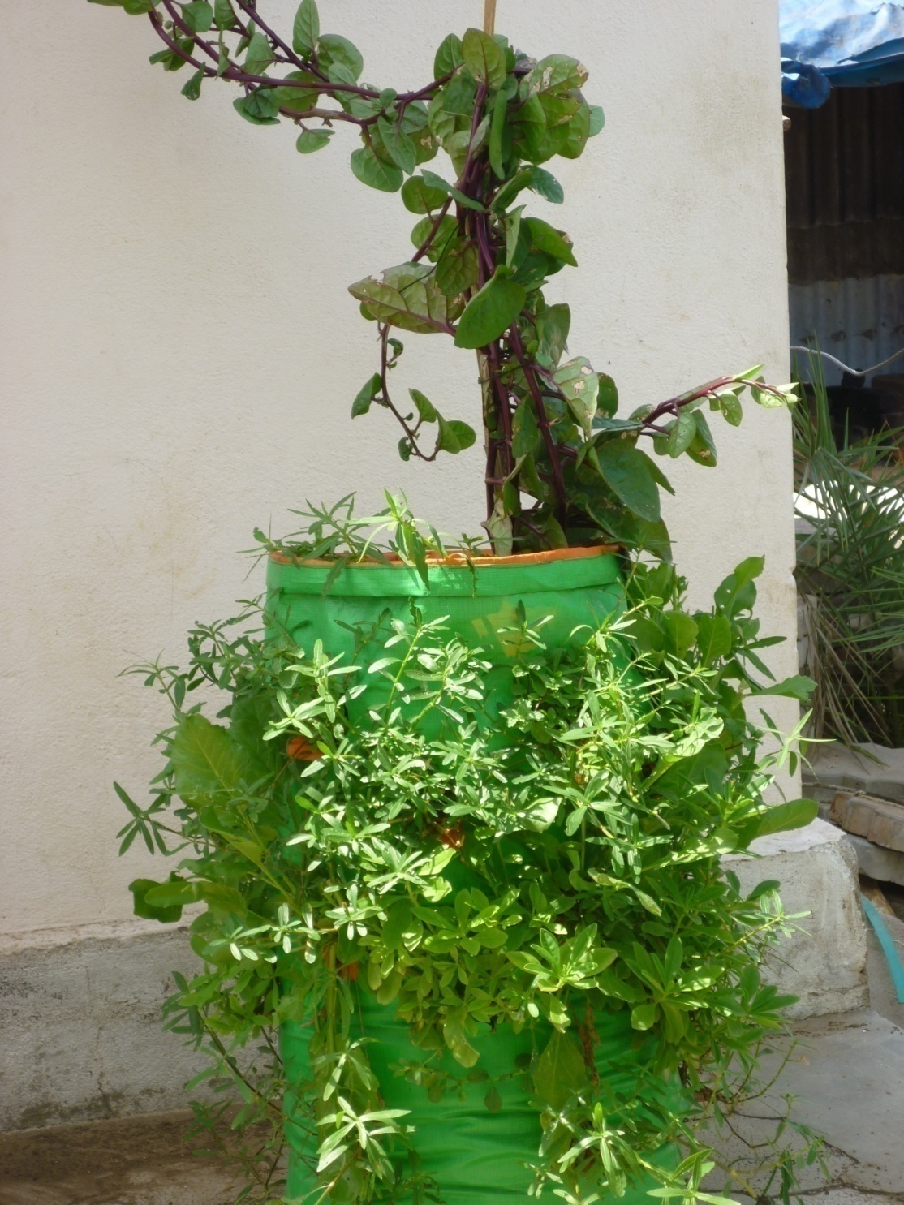
GROW KITS
5 in 1 greens kit – Suitable for apartments & small balcony

Slide 10
MAINTENANCE
Feeding Organic Seaweed Fertilizer packet weekly once for first 5 weeks.
Watering the plants thrice a week.
During first three weeks, watering should be done carefully. Since it’s a baby plant, stems will be sensitive.
Spray Organic Pesticide – Eco Shield weekly once.
Make sure of insect attacks.
Place the plants (like mint, lettuce, celery, parsley, capsicum, lemon verbana, pepper mint, spear mint) in half shade sunlight.
Involve your kids to take care of the plants.

Slide 11
COCO PEAT | SOIL
Will stay loosen even after watering. Helps the roots to penetrate easily. | Soil gets tighten after watering. So the roots penetration will be tough.
Absorbs water. Usage of the water is less. | Soil doesn’t absorb s water. So watering is needed daily.
Nutrients will stay in the coco peat. So the fertilizers will be needed in less quantity. | Nutrients will not stay in the soil.. Plants absorb only 2% of the supplements. Remaining goes to the earth.
Weighs less. Terrace will not be much loaded . | Soil weighs high. Thus the roof will be loaded which is dangerous.
COMPARISON

Slide 12
What all plants can be grown in grow bags?
GREENS
Coriander, Mint, Vallarai, Manathakkali, Dill, Fenu Greek, Palak, Ponnanganni (Red & Green), Spinach (Green & Red ), Gongura, Siru Keerai, Arai Keerai, Chakravarthy, Ceylon Pasalai, Creeping Pasalai, Drumstick, Agathi, Thavasi
LEAFY GREENS
Celery, Lettuce, Parsley

Slide 13
What all plants can be grown in grow bags?
VEGETABLES
Tomato, Brinjal, Lady’s Finger, Chili, Country Beans, Cluster Beans, Carrot, Beet Root , Beans, Capsicum, Radish, Bitter Gourd, Bottle Gourd, Snake Gourd, Ridge Gourd, Cucumber
FRUITS
Pomegranate, Guava, Sapota, Papaya, Lemon

Slide 14
What all plants can be grown in grow bags?
HERBS
Insulin plant, Parvathy leaf, Karpuravalli, Rosemary, Thulasi, Thyme, Pirandai, Rue, Aloevera, Vettiver, Siriyanangai, Lemongrass, Spear Mint, Pepper Mint, Thoothuvalai, Lemon Balm, Lemon Verbana, Mudakkathan, Karisalanganni, Adathoda, Vetrilai

Slide 15
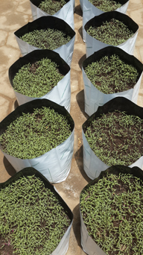
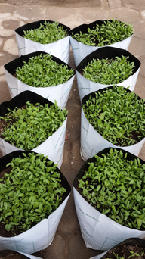
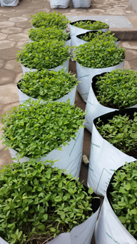
GROWTH OF THE VARIOUS STAGES OF GREENS

Slide 16
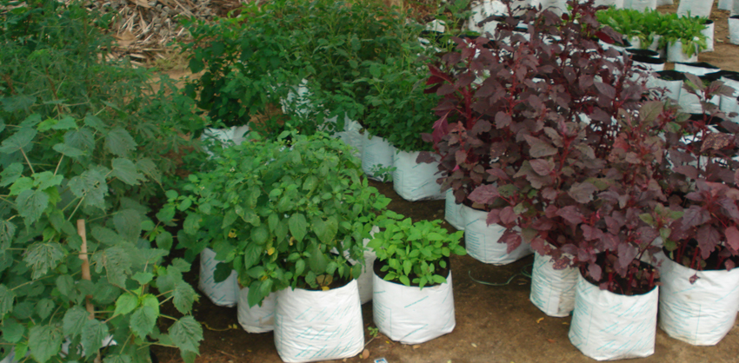
GREENS GROWN IN GROW BAGS

Slide 17
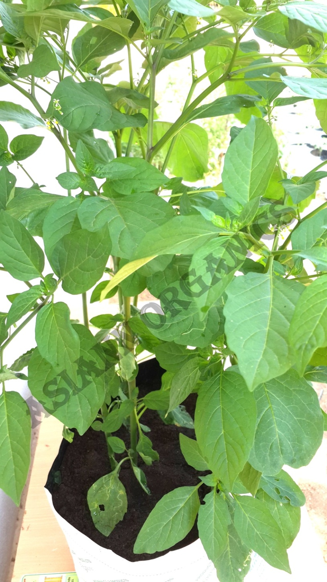
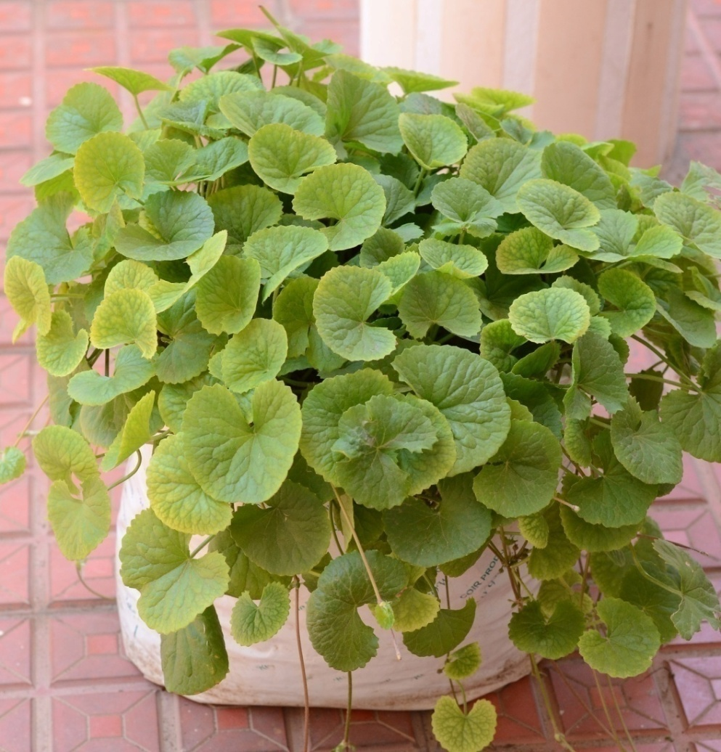
  MANATHANKALLI & VALLARAI IN
  EASY GROW KIT

Slide 18

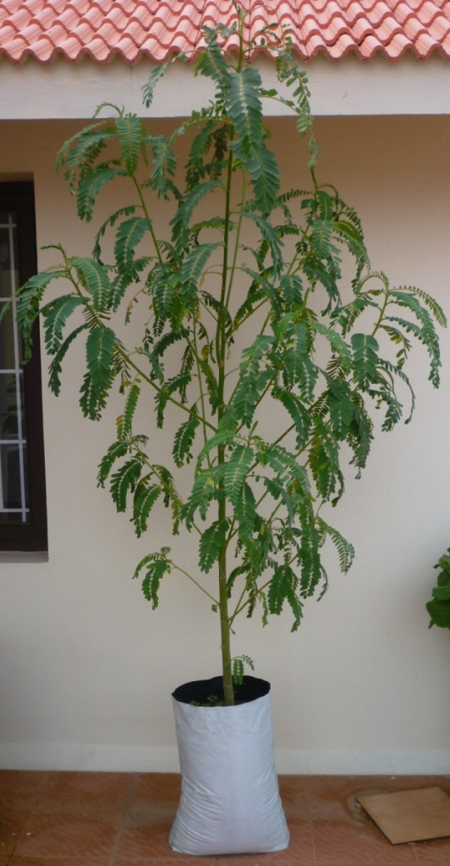
  CREEPING PASALAI & AGATHI GREENS IN
  JUMBO EASY GROW KIT

Slide 19
VEGETABLES GROWN IN GROW BAGS

Slide 20
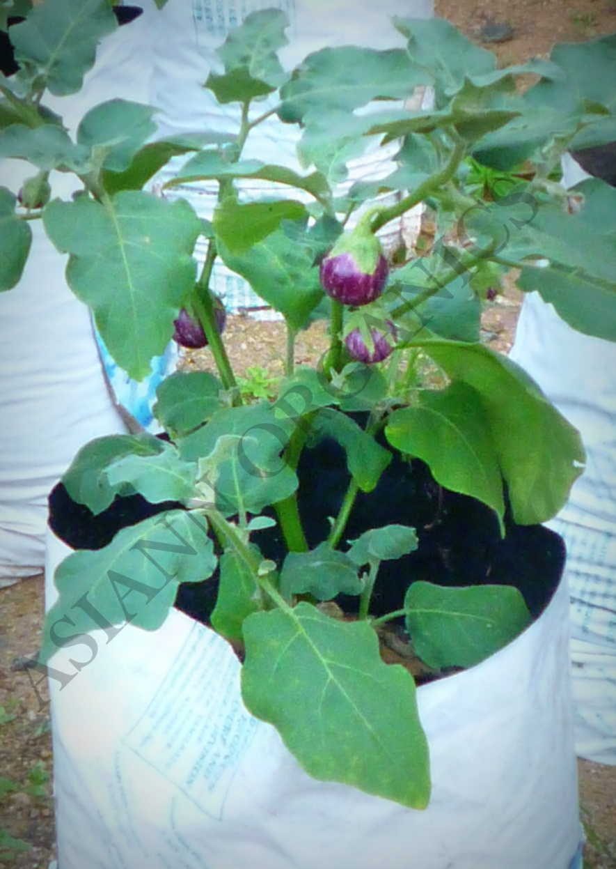
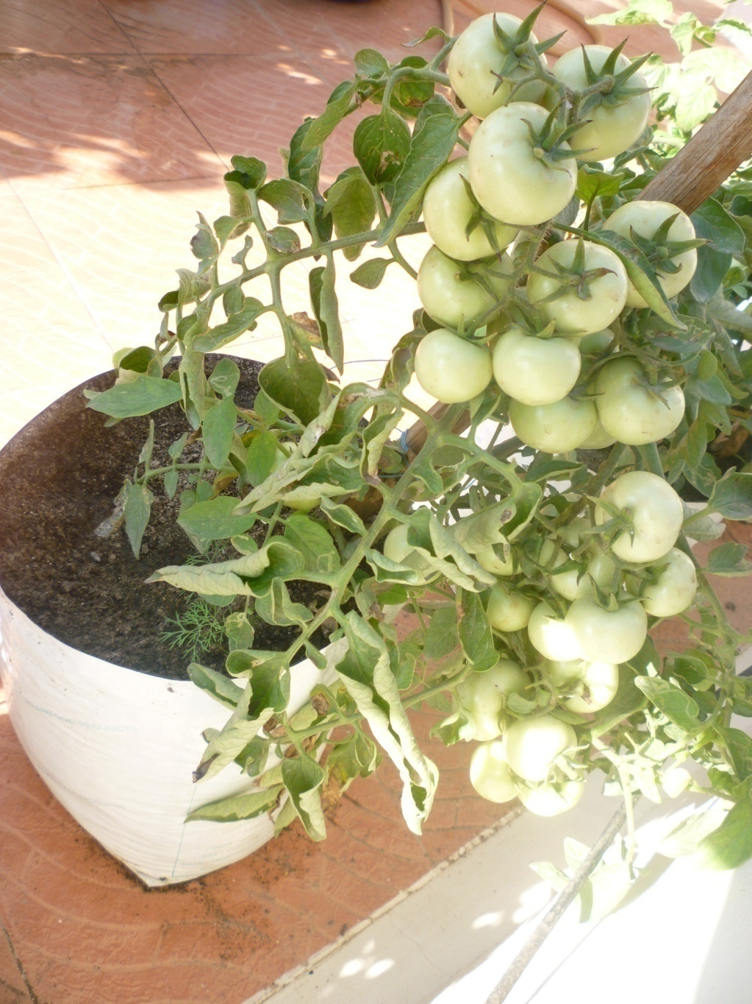
  BRINJAL & TOMATO IN EASY GROW KIT

Slide 21
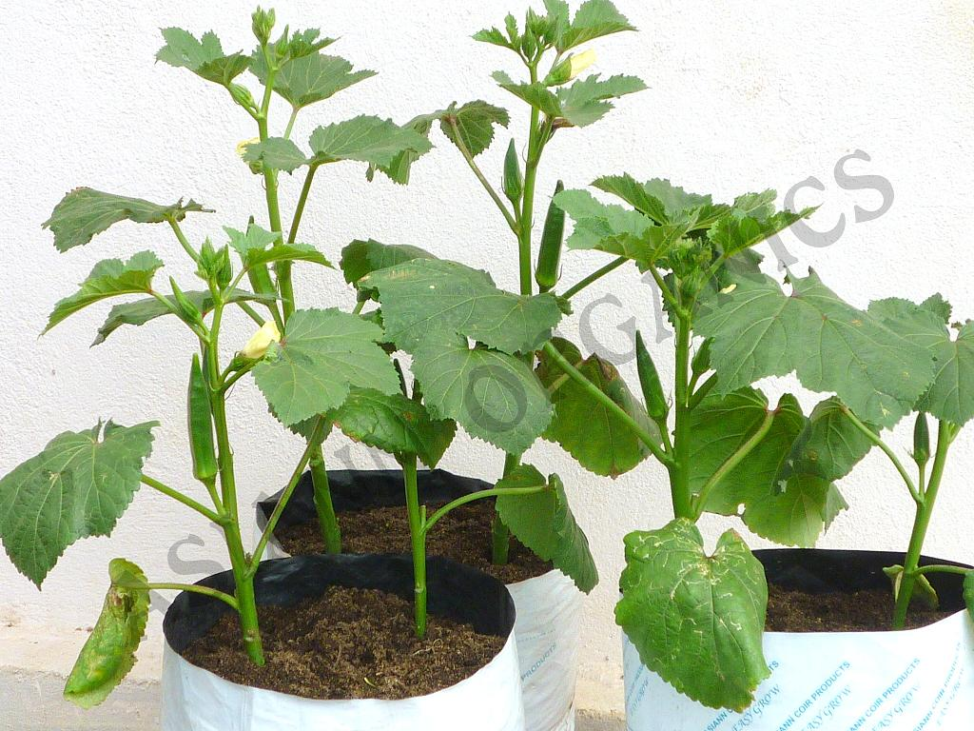
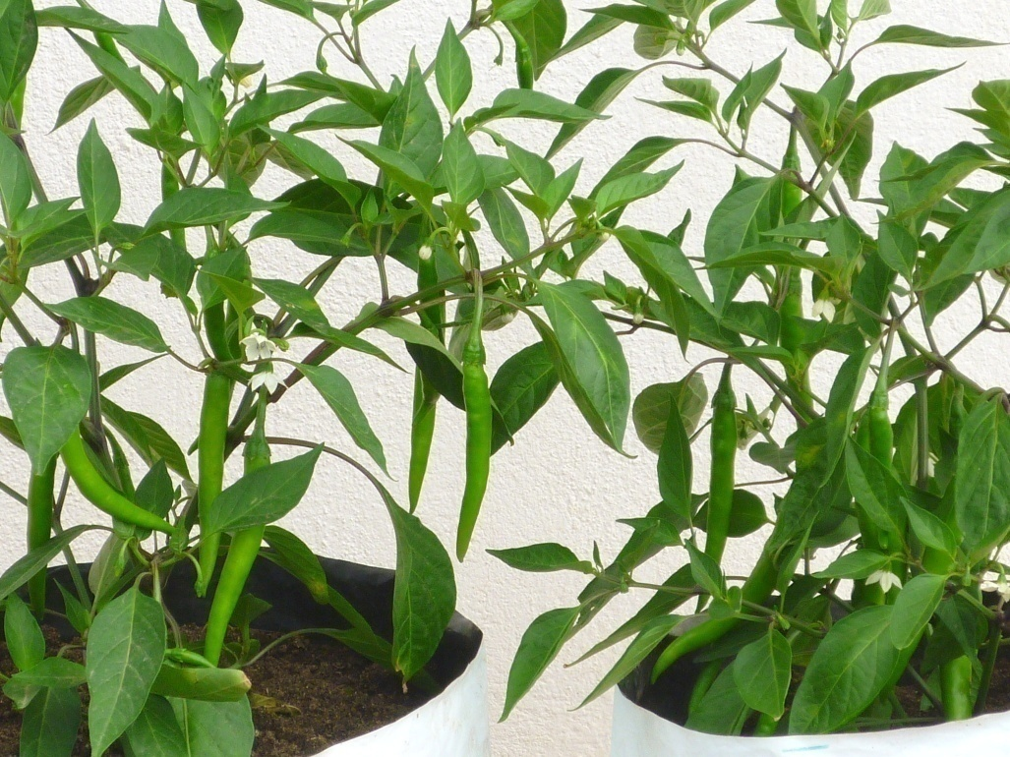
  LADY’S FINGER & CHILI IN EASY GROW KIT

Slide 22
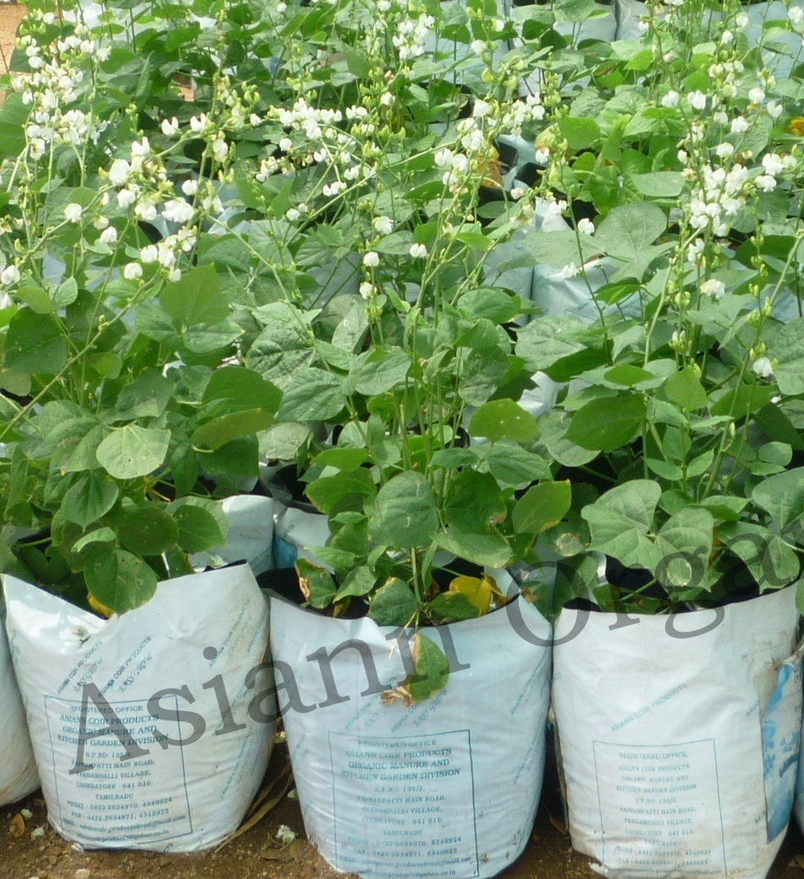
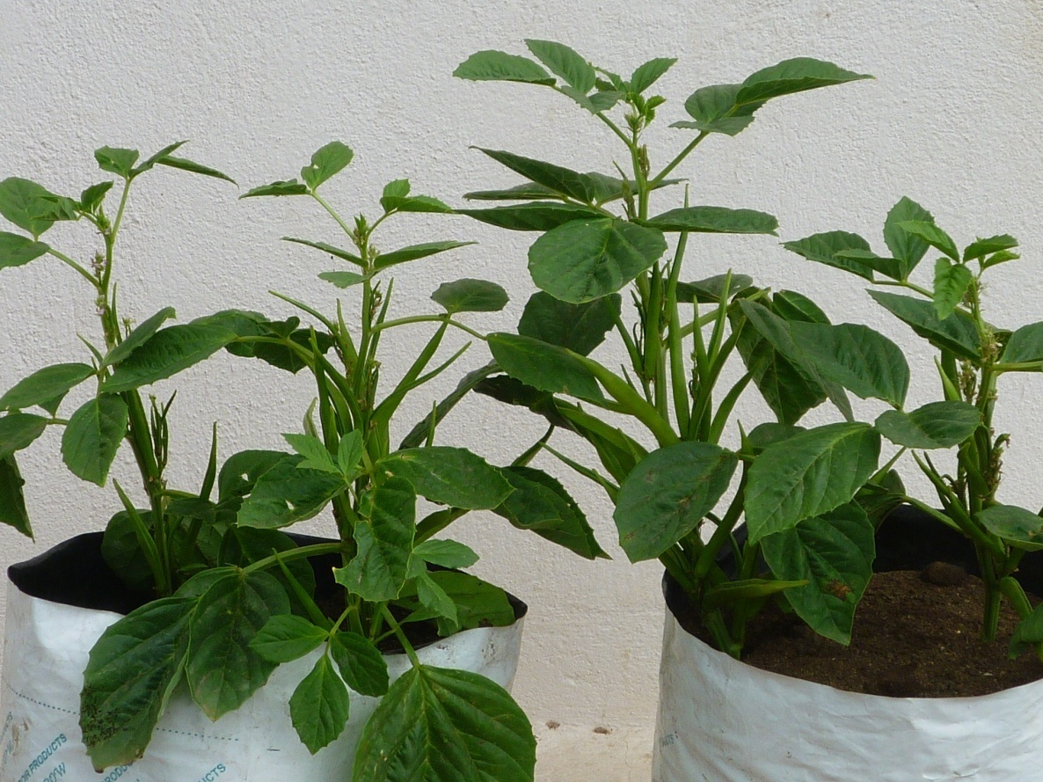
  COUNTRY BEANS & CLUSTER BEANS IN EASY GROW KIT

Slide 23
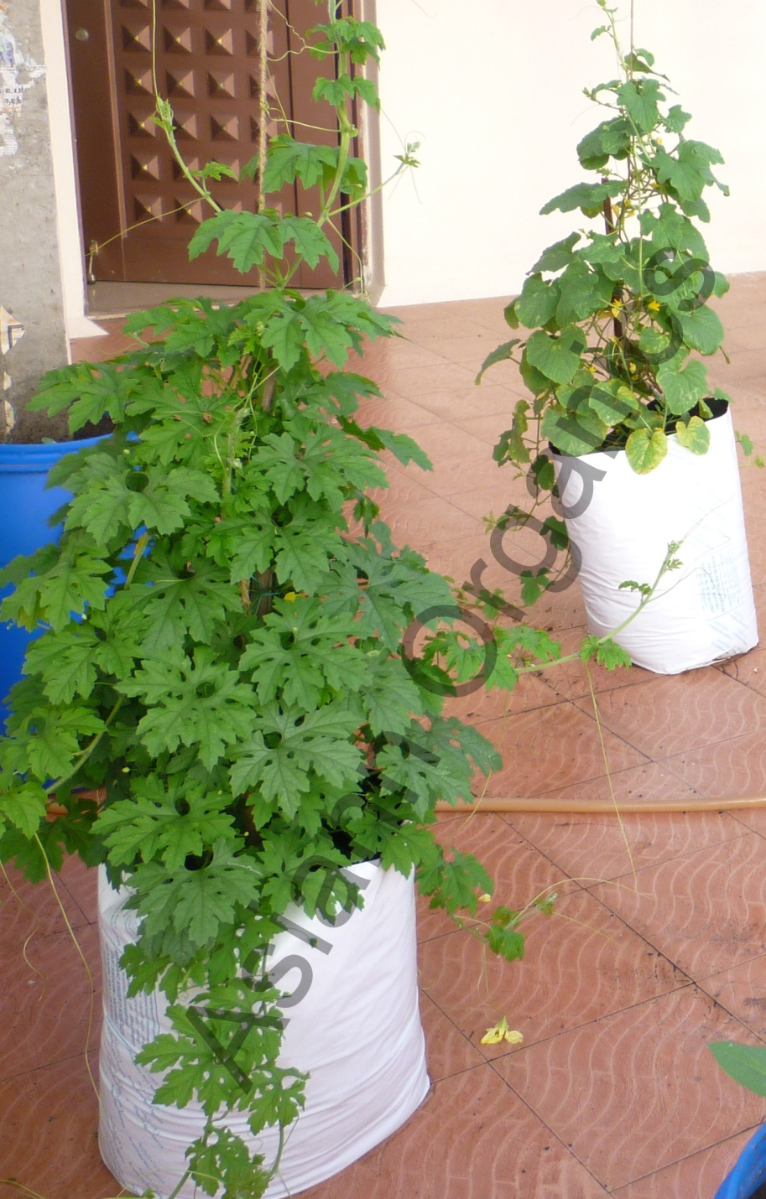
  BITTER GOURD & CUCUMBER IN JUMBO EASY GROW KIT

Slide 24
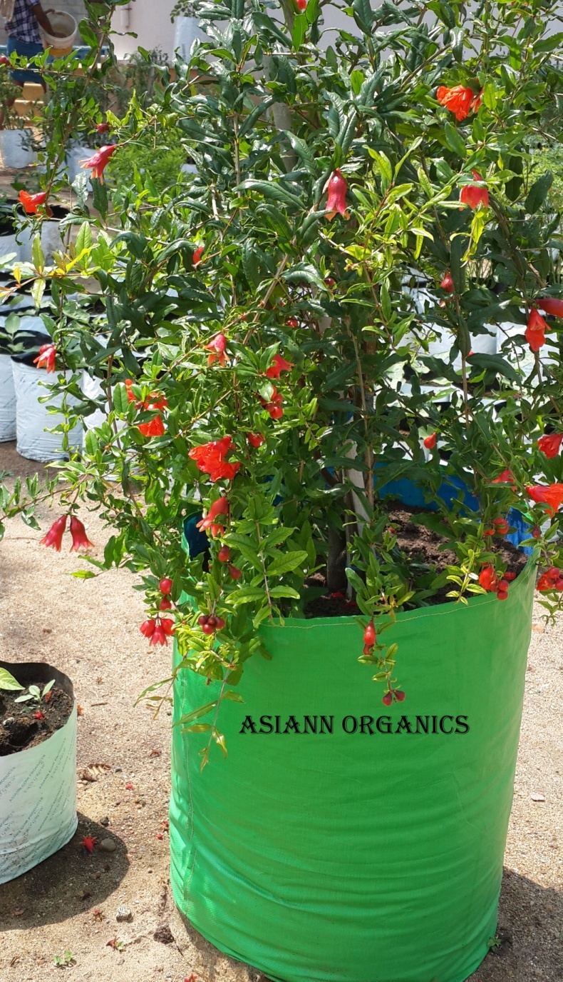
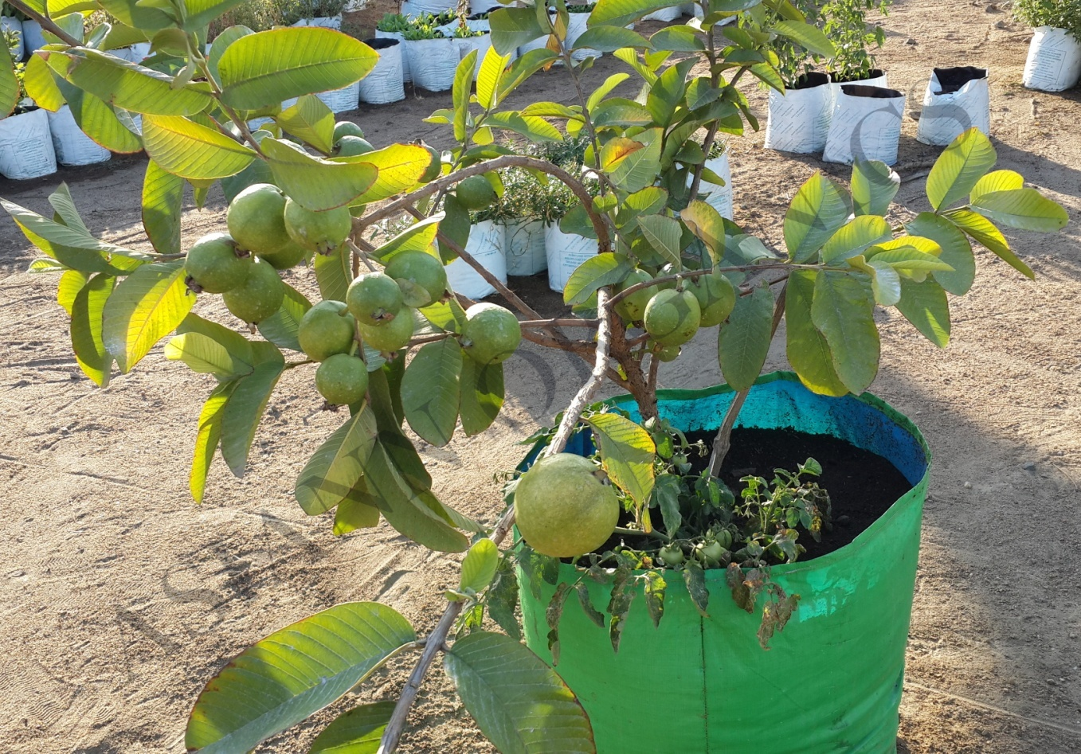
  POMEGRANATE & GUAVA IN
  FRUITS KIT

Slide 25
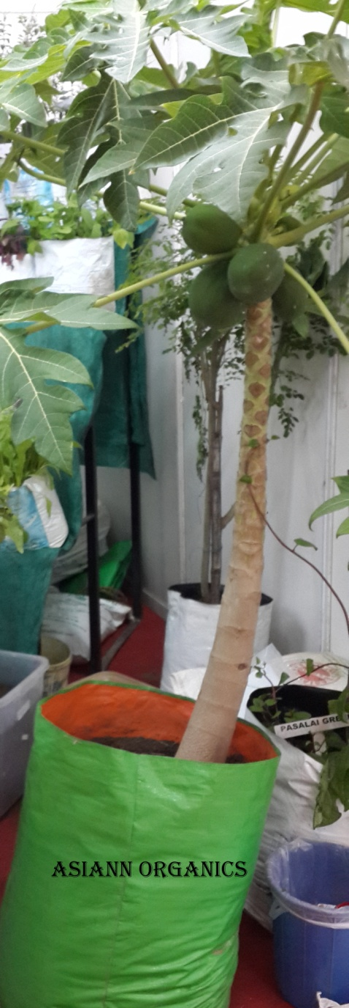
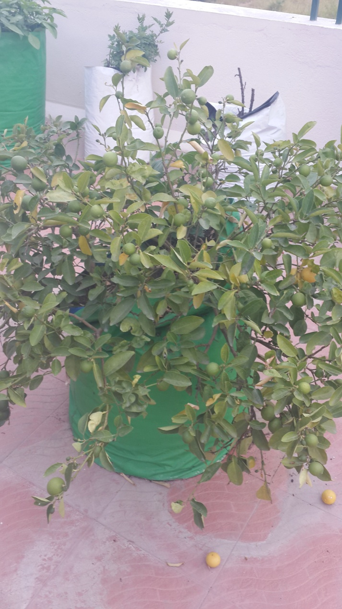
  PAPAYA
  &
  LEMON
  IN FRUIT KIT

Slide 26
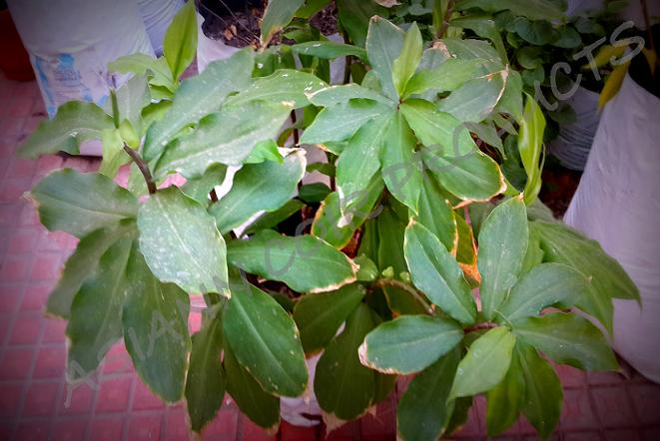
  INSULIN PLANT IN EASY GROW KIT
Controls Diabetes
Intake two leaves daily morning & evening for a month. Later continue by having a leaf daily morning & evening

Slide 27
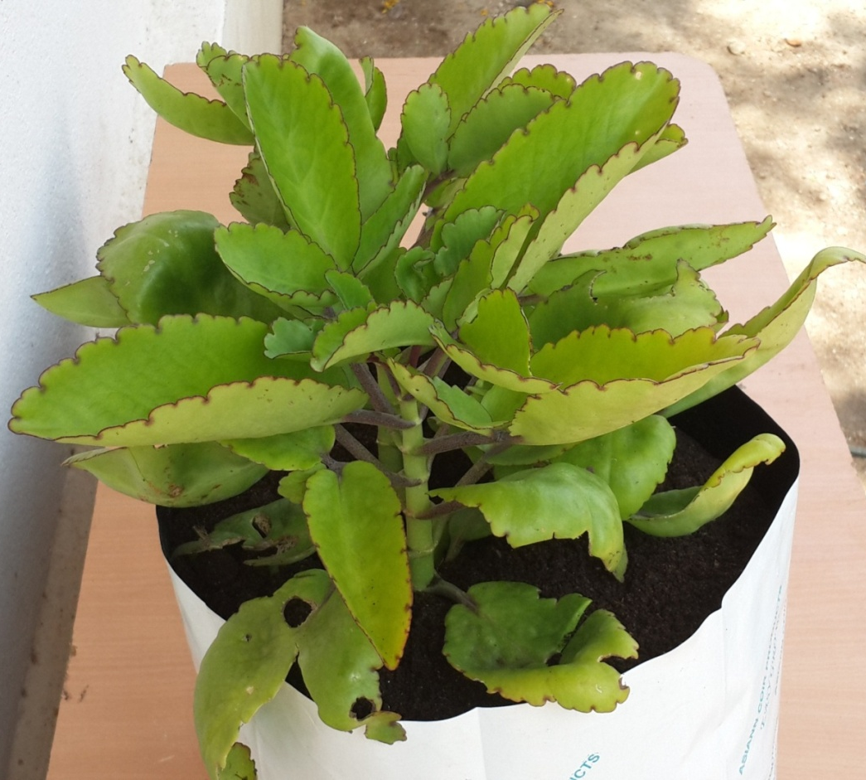
  PARVATHY LEAVES IN EASY GROW KIT
Cures Kidney Stone
Intake a leaf daily in empty stomach every morning for 17 days.
The stones starts to reduce its size.

Slide 28
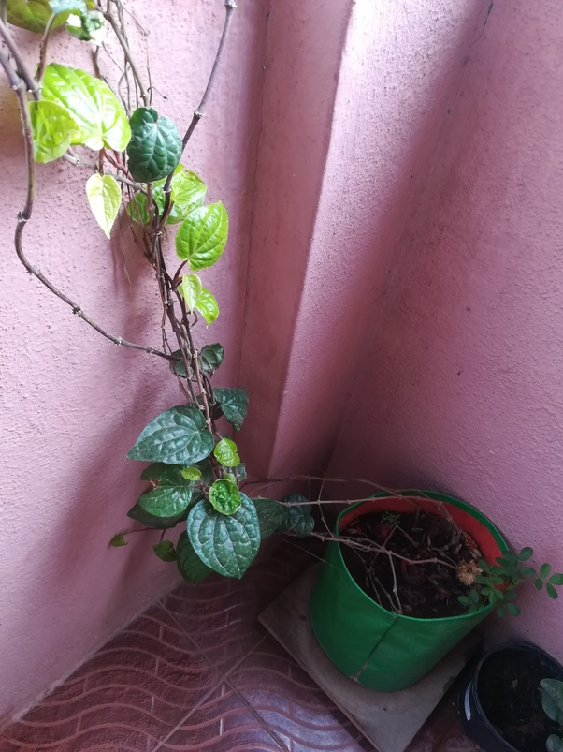
  BETEL LEAVES IN EASY GROW KIT
Cures Cold
Intake Betel Leaves
tea cures cold, fever & head ache.

Slide 29
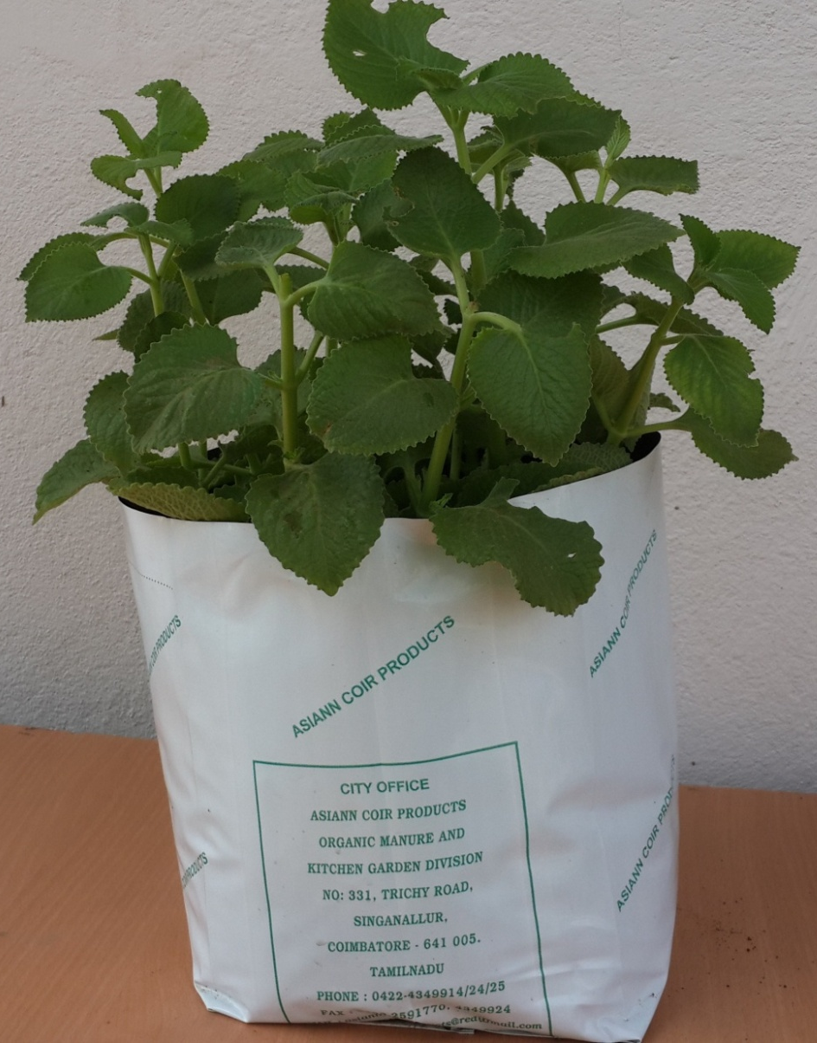
  KARPURAVALLI IN EASY GROW KIT
Cures Cold & Cough
Reduce Nasal congestion & Sore Throats in adults
Helps in Digestion & Stomach Upset
Anti - Hypertensive

Slide 30
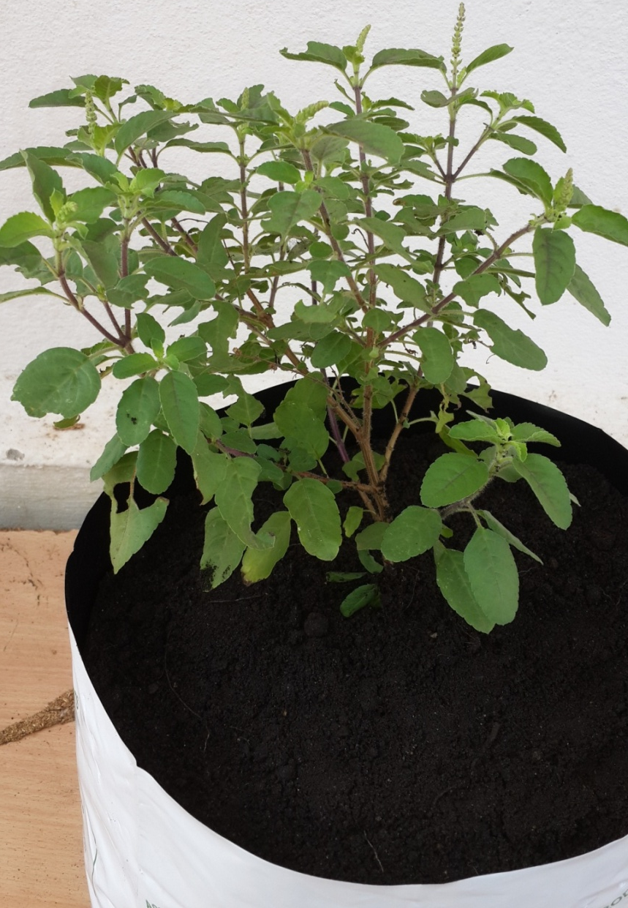
  TULASI IN EASY GROW KIT
Cures Cold, Cough & Headache
Increases WBC and thus fights against Cancer.
Protects Heart
Dissolve Kidney Stones
Good for Skin & Hair

Slide 31
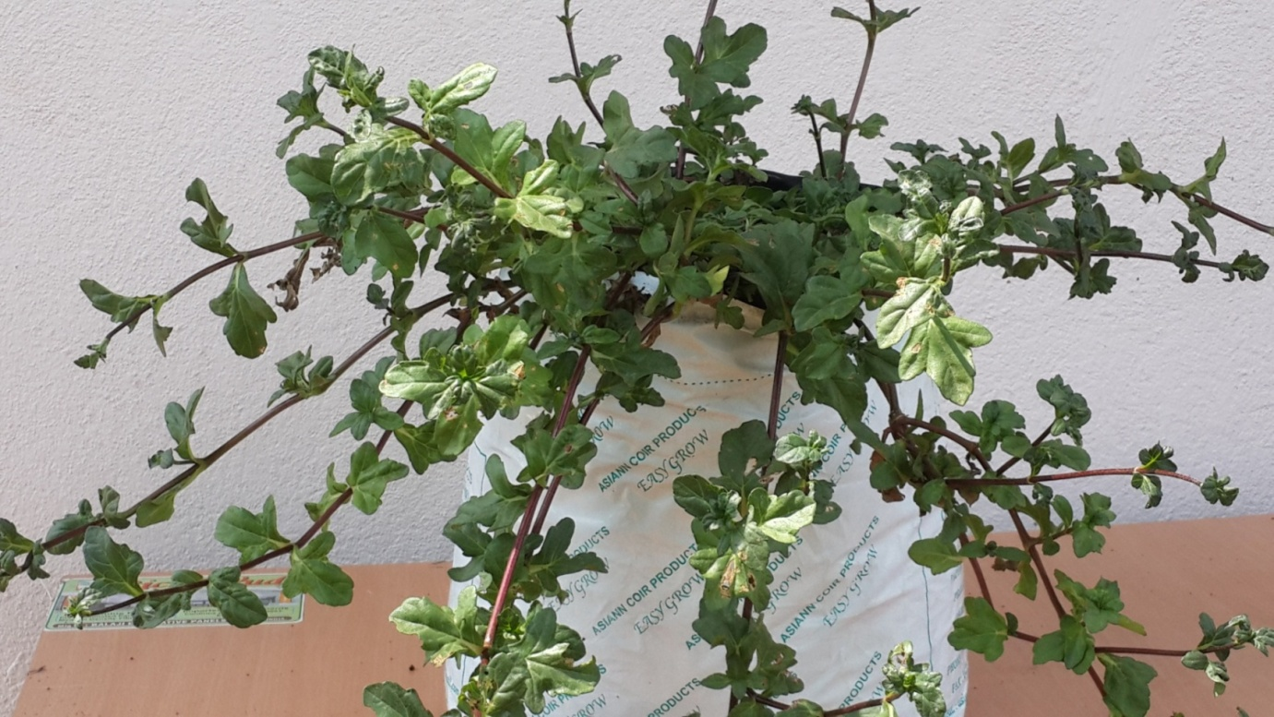
  KARISALANGANNI IN EASY GROW KIT
Best remedy for Hair Growth, Grey Hair, Baldness, Treats Liver Disorder, Cures Skin related disease, Anemia & Sinus Infection

Slide 32
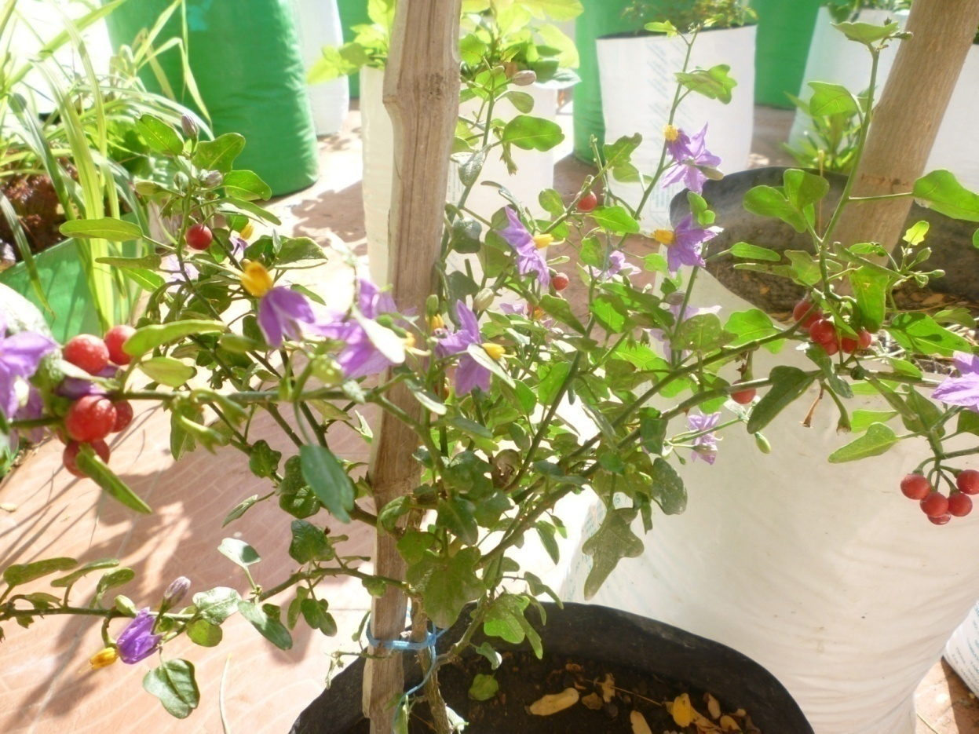
  THOOTHUVALAI IN EASY GROW KIT
Very effective for
Chest Congestion
Cough
Blocked Nose
Sinus Infection

Slide 33
How to use Herbs to raise your immunity ???
HERBS
Take each 5 leaves of Thuthuvali leaves, Vetrilai leaves, Thulasi leaves,Karisalanganni leaves, Karpooravalli leaves, Ginger a small piece, Pepper 10 nos & turmeric ¼ spoon. Boil this with 200ml water. After 5 minutes filter this & drink. This will help you to raise your immunity in this pandemic situation .

Slide 34
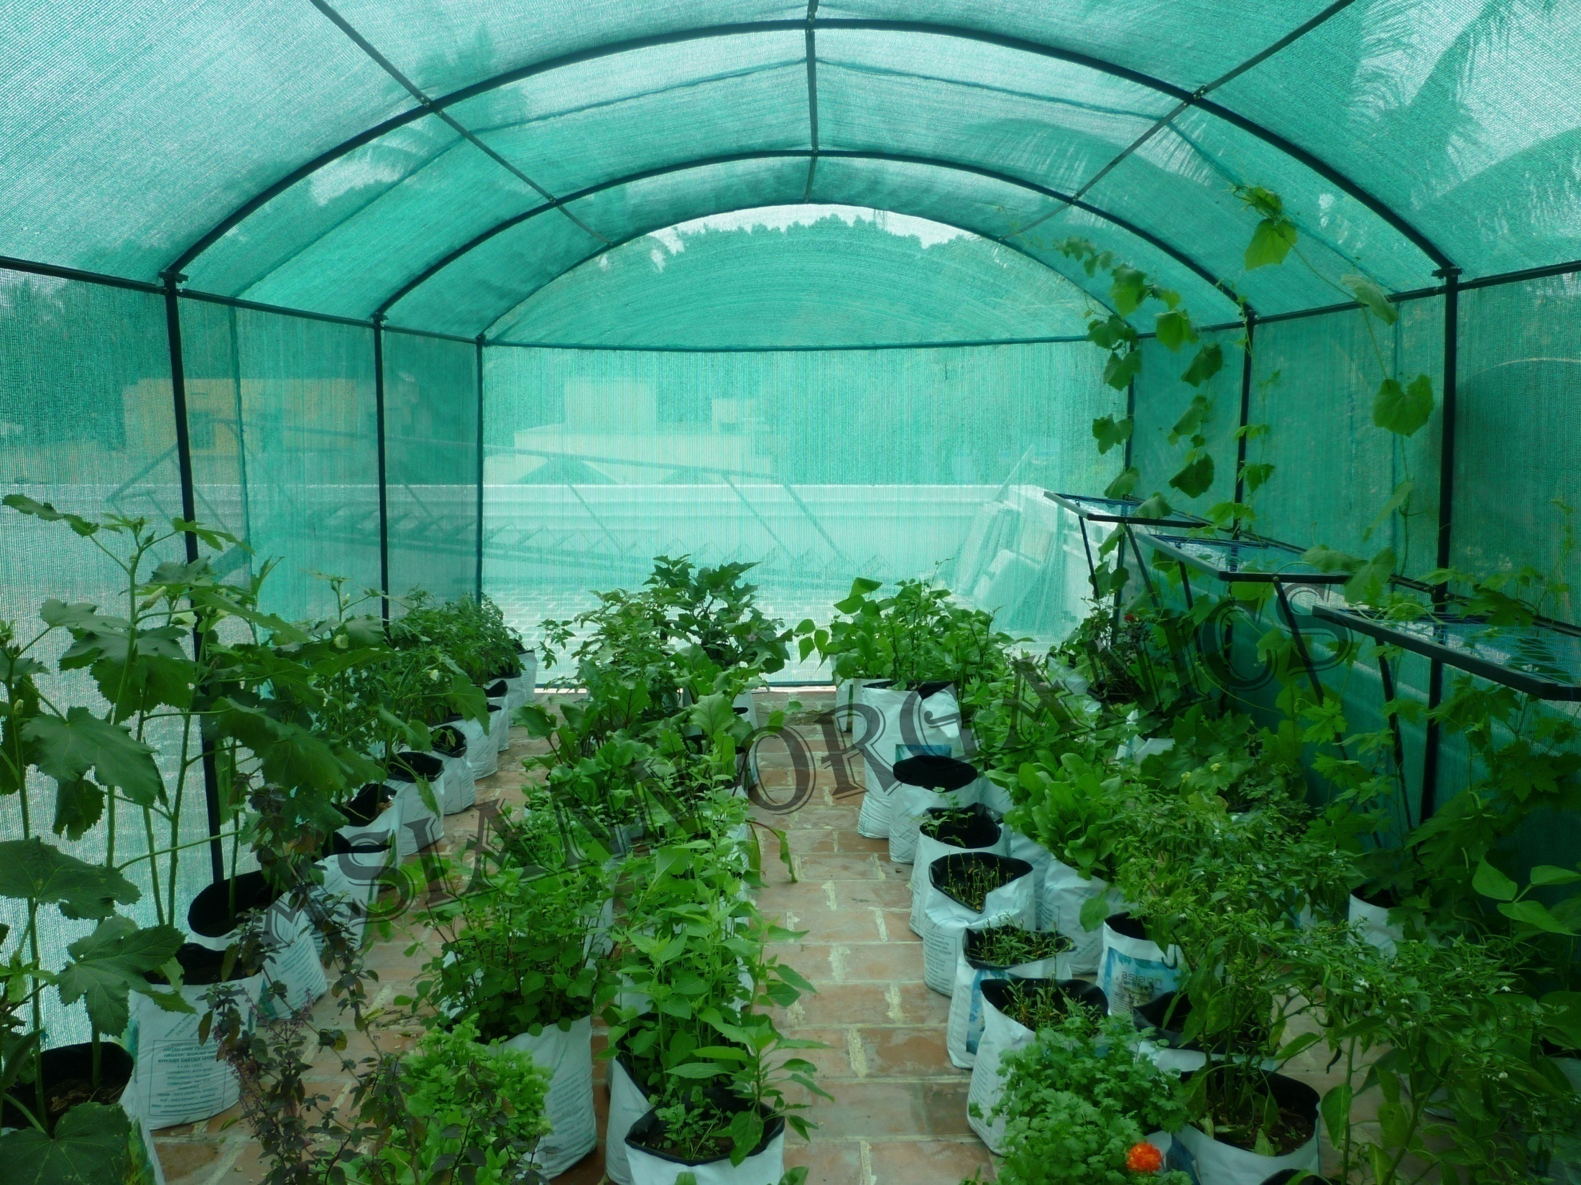
GREEN HOUSE

Slide 35
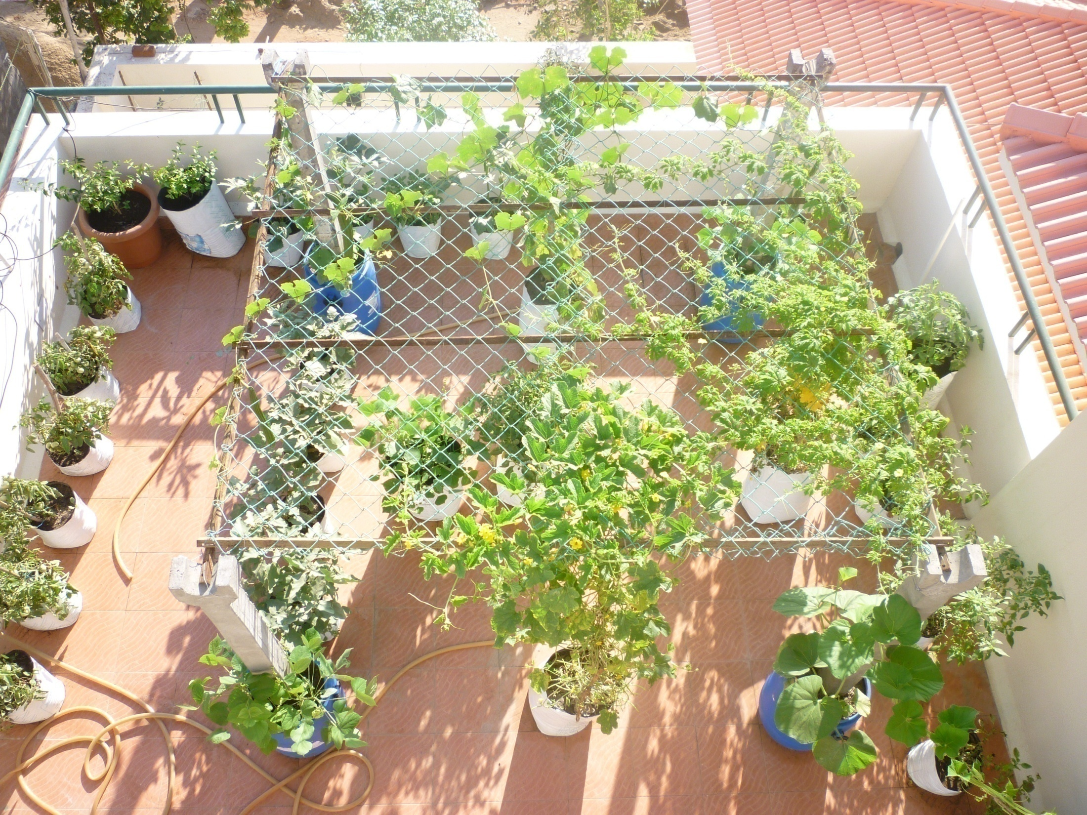
ORGANIC VEGETABLES ON MY TERRACE!

Slide 36
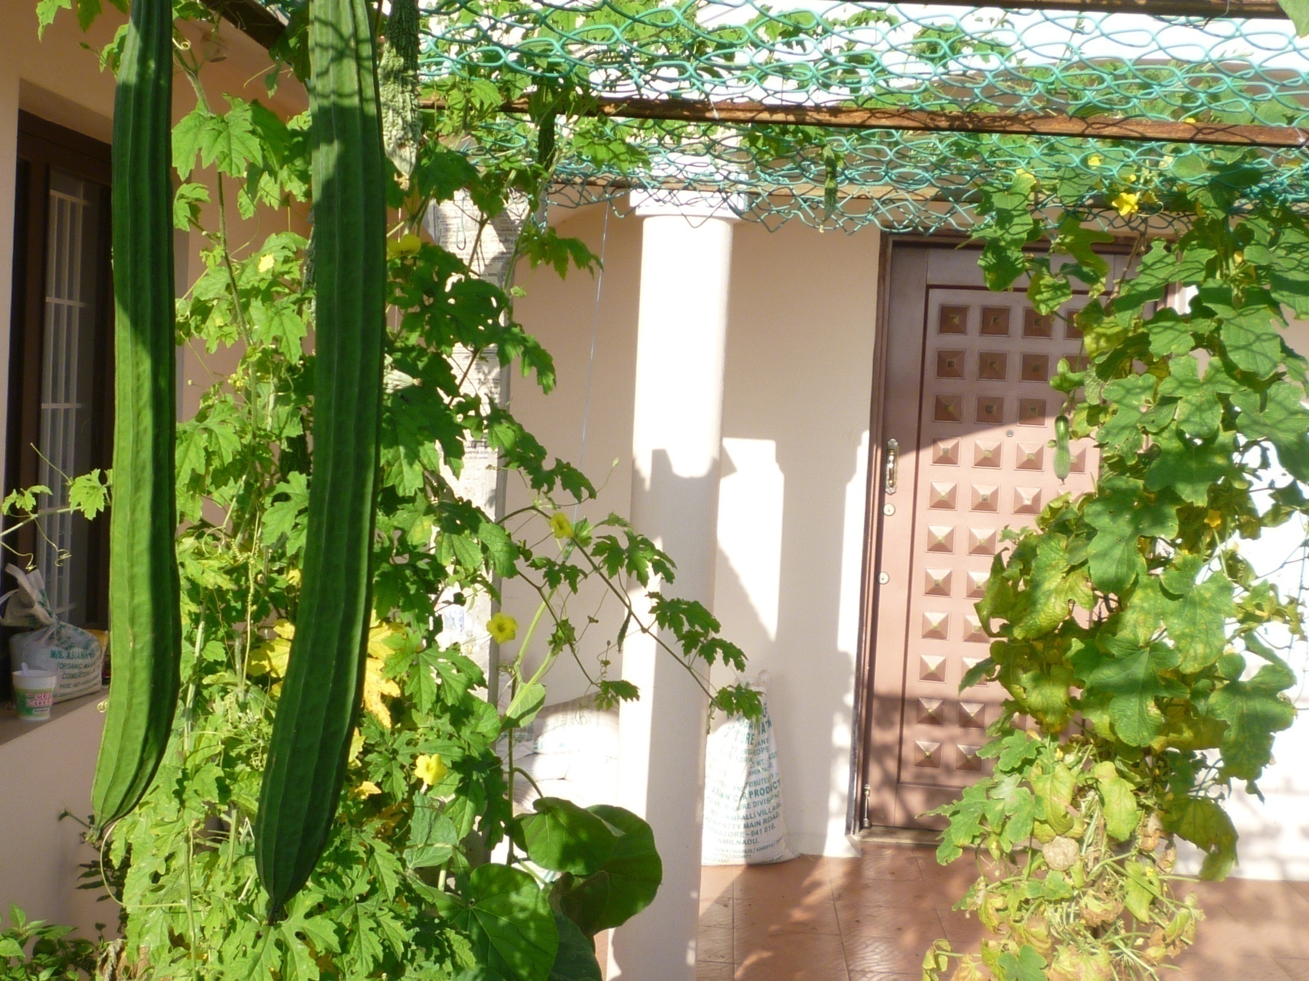

Slide 37
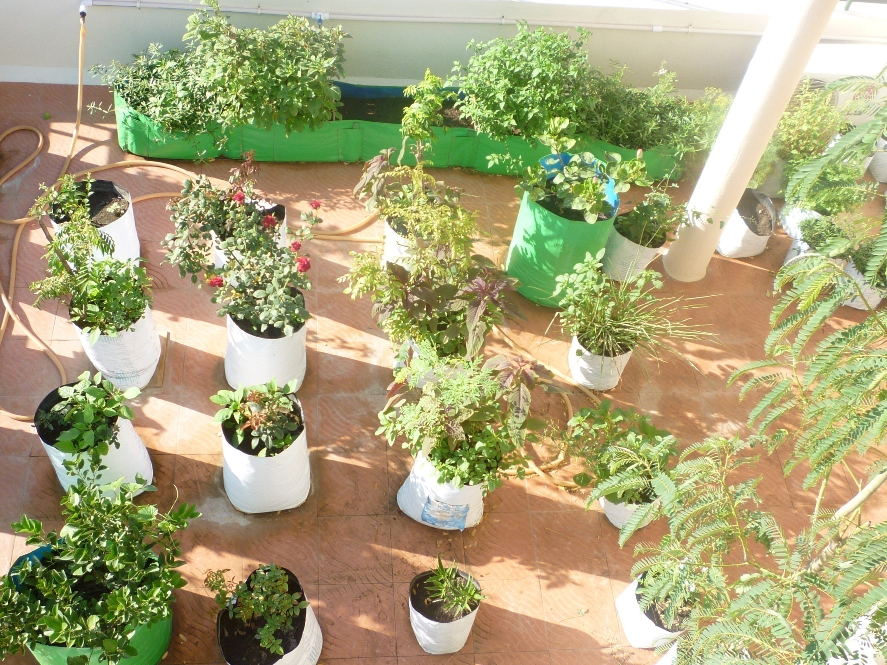

Slide 38
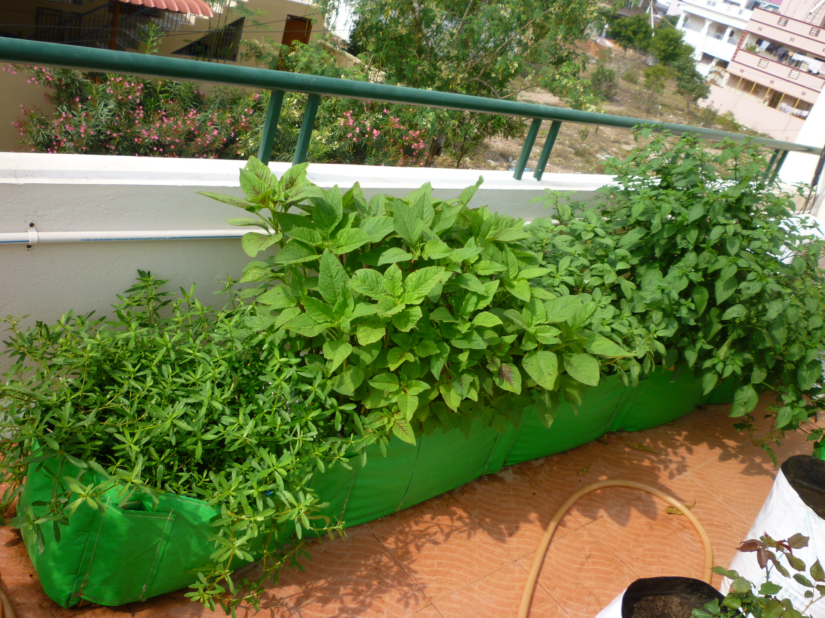

Slide 39
NOW ITS TIME FOR YOU TO ENJOY YOUR ORGANIC GARDEN !!!

Slide 40

THANK YOU
FOR
YOUR PATIENCE

