Slide 1


Go Green Save Grain
Tamil Nadu Agricultural University
STORED GRAIN PEST MANAGEMENT
GADGETS AND THEIR IMPACTS
Dr. S. MOHAN
Specialist in Stored Product Insect Monitoring and Management through Green Technology
Professor (Agrl. Entomology) Retd. &
Former Dean (School of Post Graduate Studies),
Tamil Nadu Agricultural University, Coimbatore

Slide 2
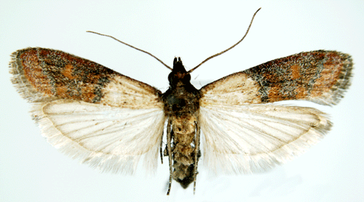
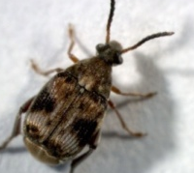
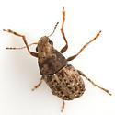
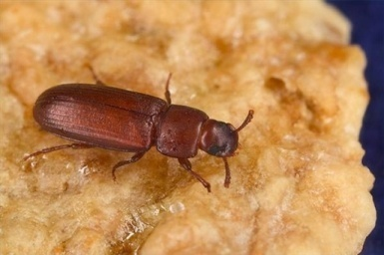
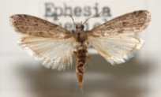
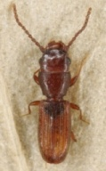
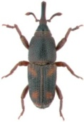
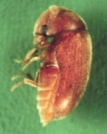

Introduction
Internal feeders
Stored Product Pests
External feeders
Storage losses in food grains
Insects 2.50 %
Rodents 2.50 %
Birds 0.85 %
Moisture 0.68 %
Total 6.53 %

Slide 3
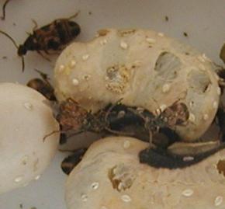
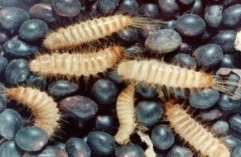
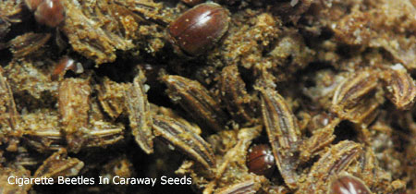
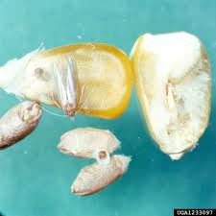
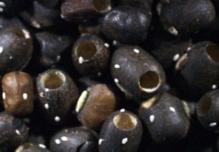
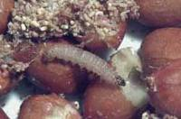
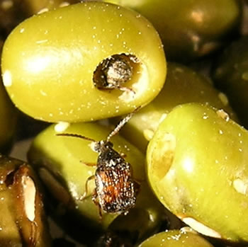
Current Status
“No Granaries can be filled with grain without insect in country like ours” - because of
  Field carry over infestation
  Cross infestation

Slide 4
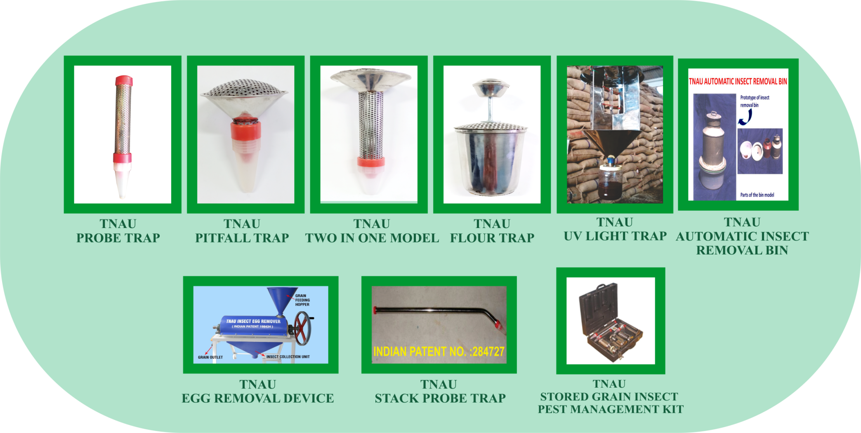
Technologies Developed
TNAU
PROBE TRAP
TNAU
PITFALL TRAP
TNAU
TWO-IN-ONE MODEL
TNAU
FLOUR TRAP
TNAU
UV LIGHT TRAP
TNAU
AUTOMATIC INSECT REMOVAL BIN
TNAU
EGG REMOVAL DEVICE
TNAU
STACK PROBE TRAP
TNAU
STORED GRAIN INSECT PEST MANAGEMENT KIT

Slide 5
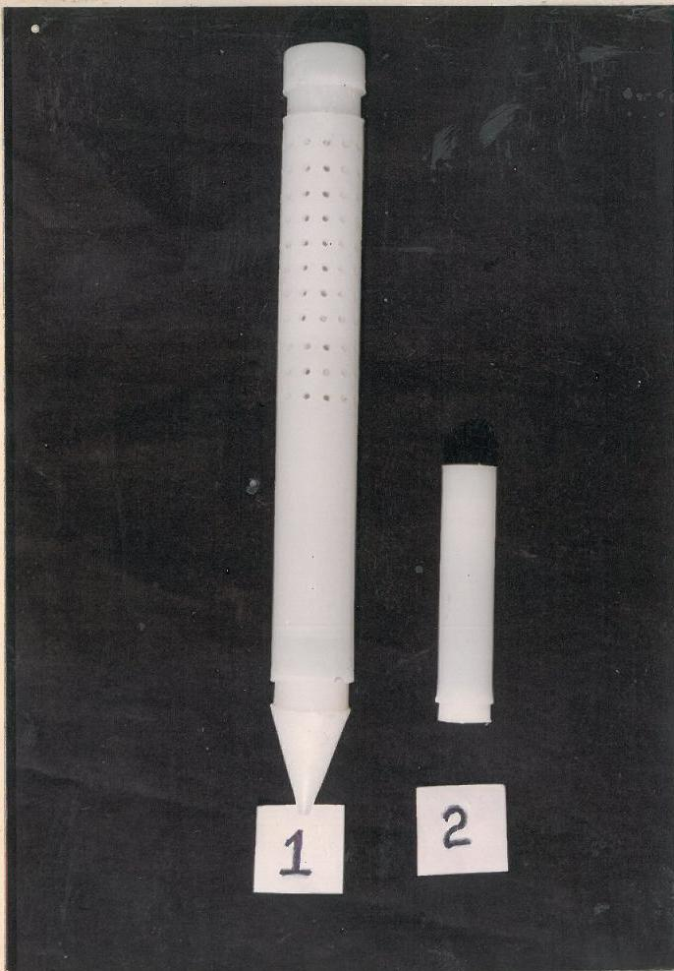
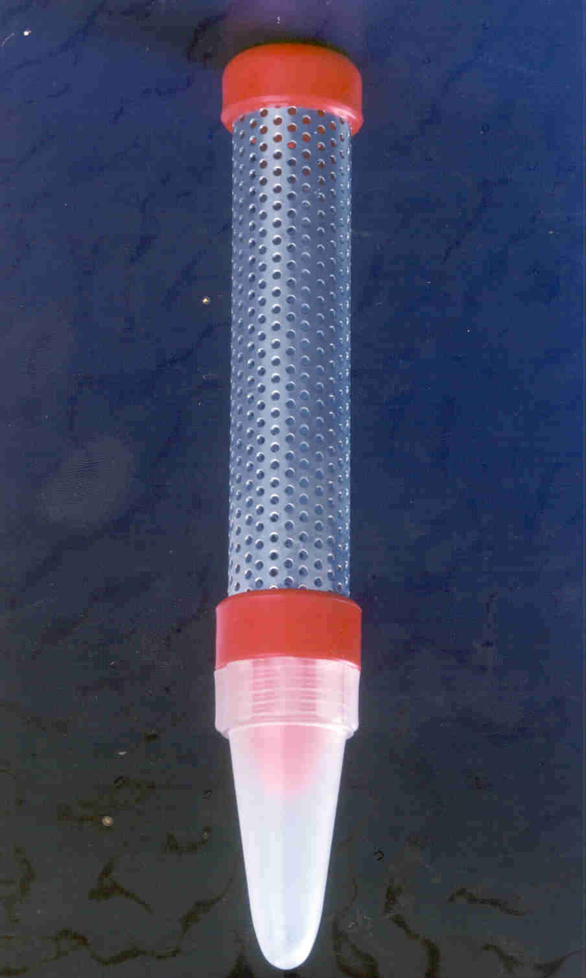
TNAU PROBE TRAP
1992
Commercial model
2002

Slide 6
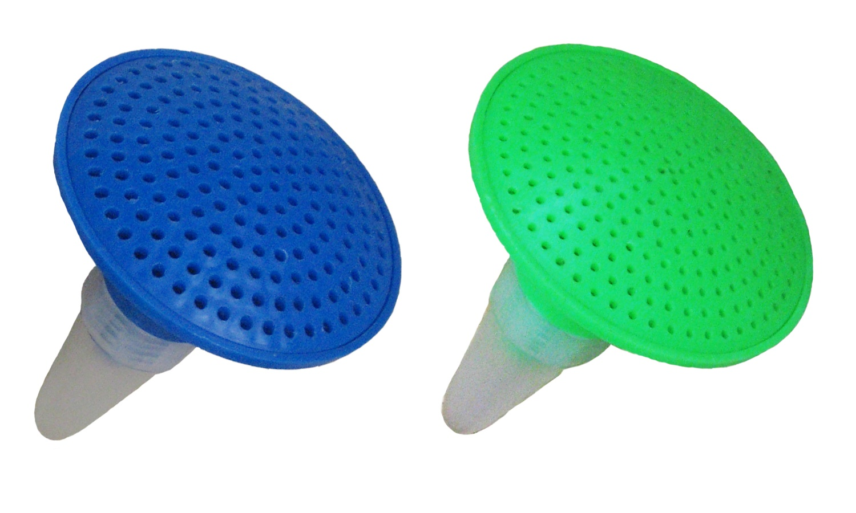
TNAU PITFALL TRAP

Slide 7
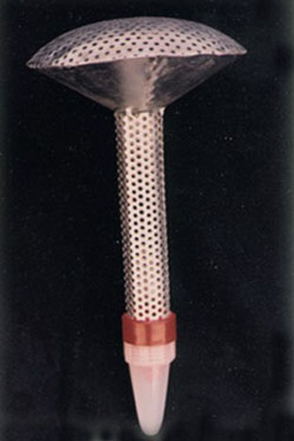
TWO IN ONE MODEL

Slide 8
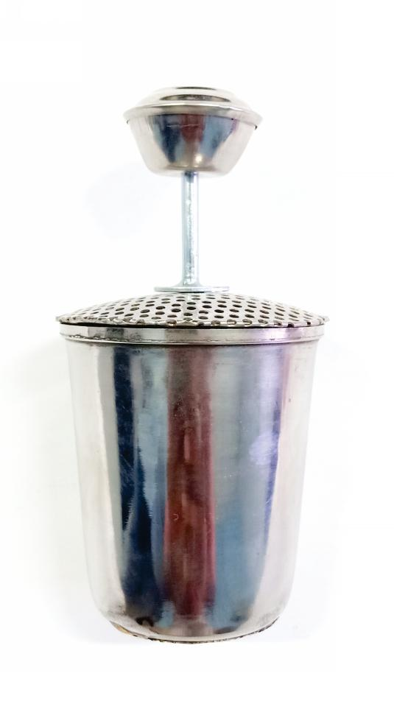
TNAU FLOUR TRAP

Slide 9
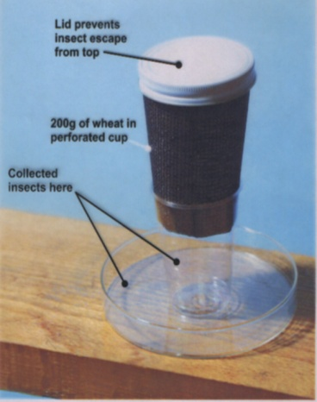
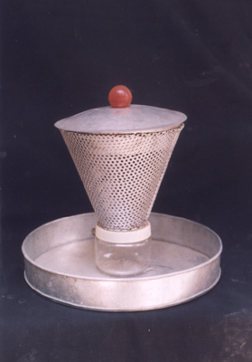
INDICATOR DEVICE
CUP BIOASSAY
Mohan and Paul Fields, 2002

Slide 10
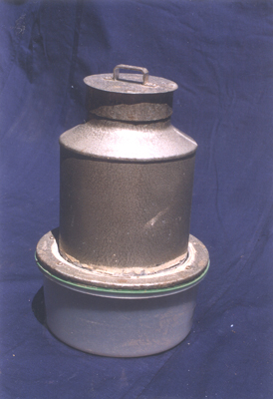
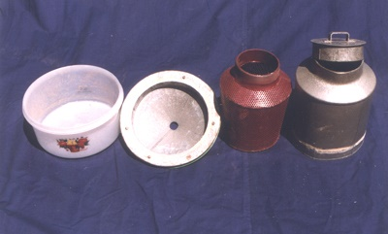
TNAU AUTOMATIC INSECT REMOVAL BIN
Prototype of insect
removal bin
Parts of the bin model

Slide 11
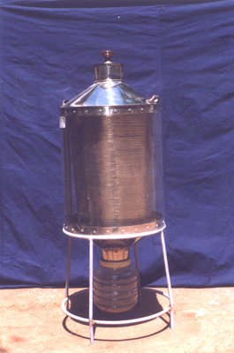
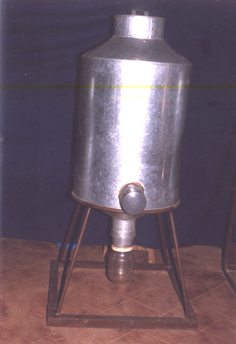
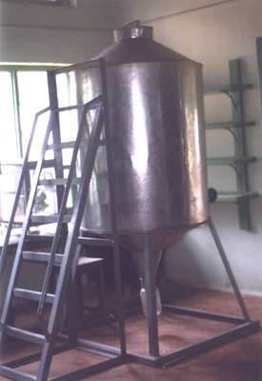
TNAU AUTOMATIC INSECT REMOVAL BIN
25 kg capacity
100 kg capacity
500 kg capacity

Slide 12
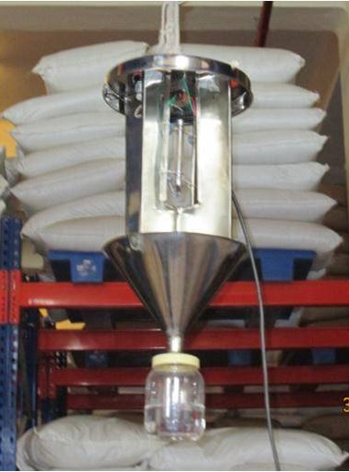
TNAU UV-LIGHT TRAP

Slide 13
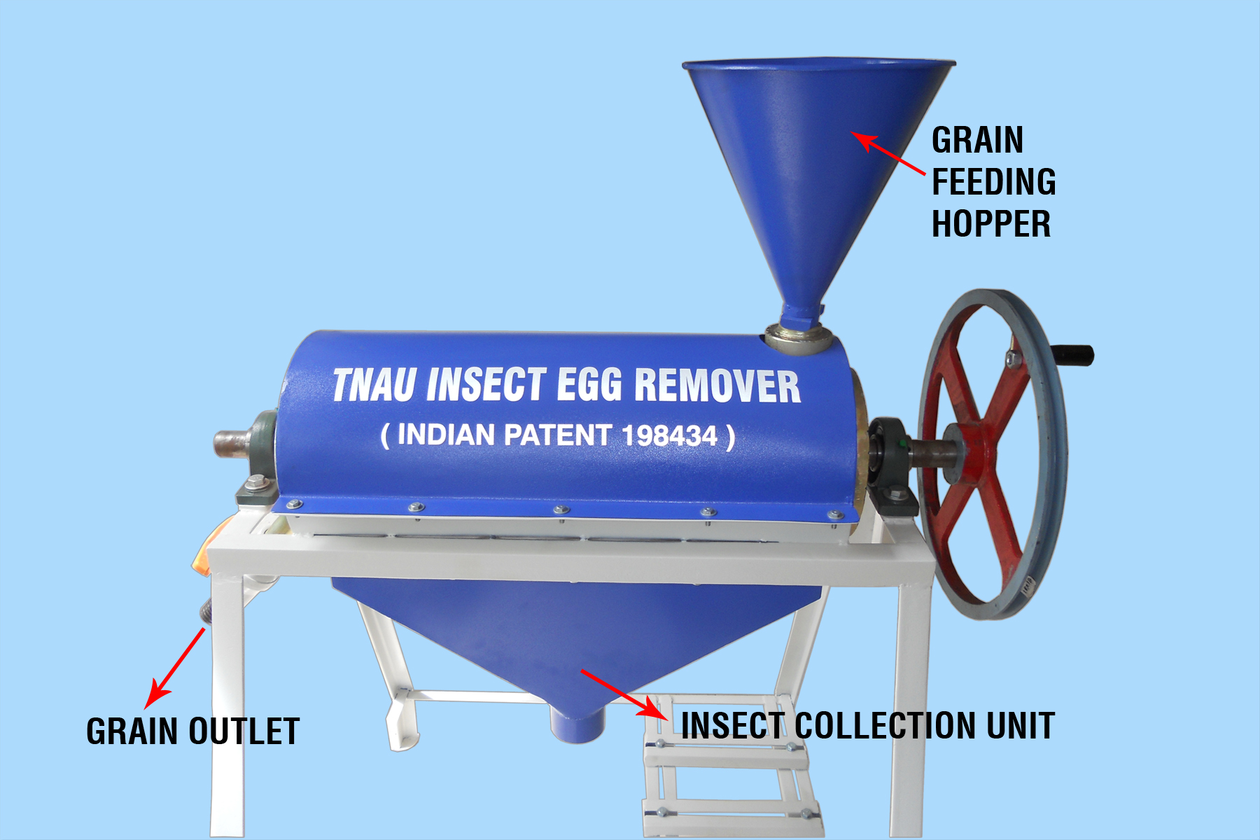
TNAU INSECT EGG REMOVER
( INDIAN PATENT : 198434 )
Hand operated
* Cleaning efficacy: 50 kg/ hr
* Approximate unit cost- Rs: 40,000/-

Slide 14
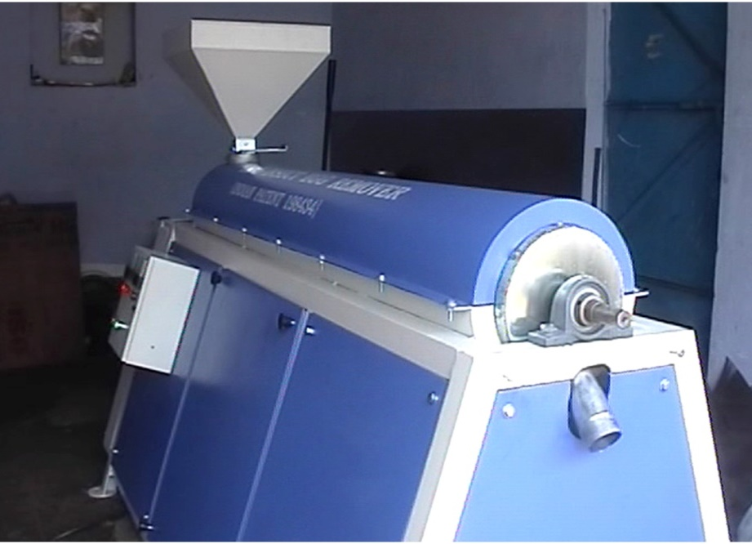
TNAU INSECT EGG REMOVER
( INDIA PATENT : 198434 )
Machine operated
* Cleaning efficacy: 200 kg/ hr
* Approximate unit cost- Rs: 1, 75,000/-

Slide 15
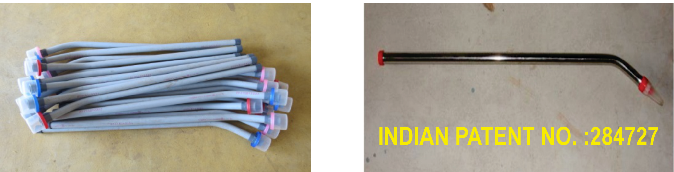
TNAU STACK PROBE TRAP
INDIAN PATENT NO. : 284727
Commercial Plastic Model
Stack Probe Trap

Slide 16
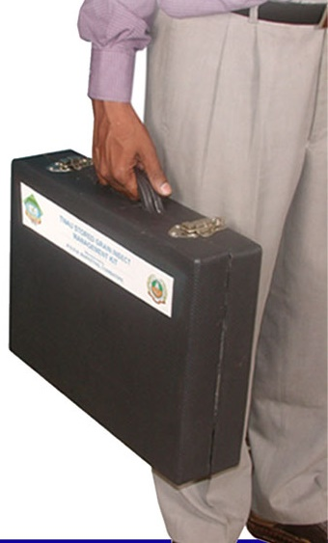
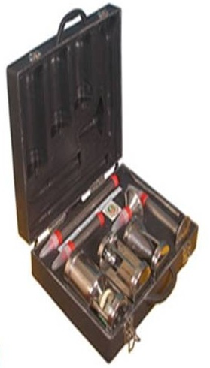
TNAU STORED GRAIN INSECT PEST MANAGEMENT KIT BOX

Slide 17
CURRENT STATUS OF THESE TRAPPING DEVICES
Publication is important
Popularization is More important
Public is Most important (End User)
TO REACH THE PUBLIC,
ENTERPRENEURS ARE VERY VERY IMPORTANT…

Slide 18
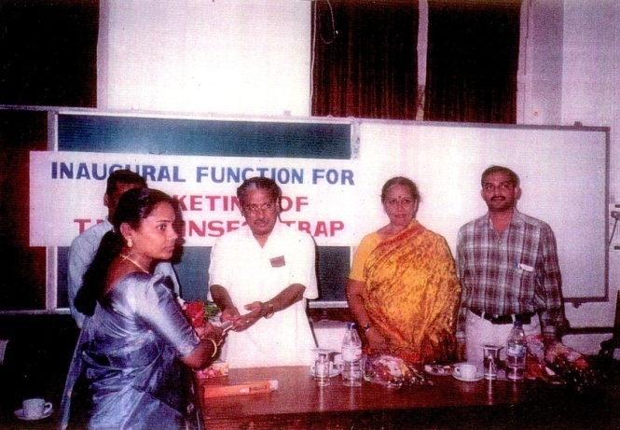
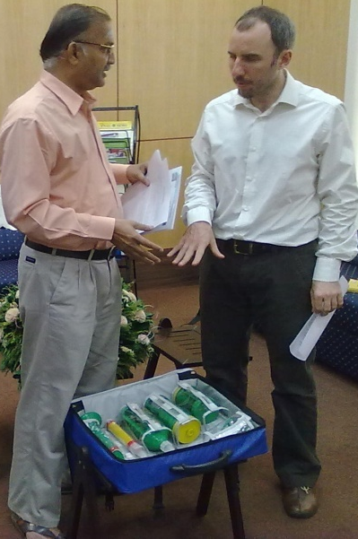
My innovations led to the birth and the growth of five Entrepreneurs in India
1.
KSNM MARKETING (2002)
SF No.29/1B, Ona Palayam,
Siruvani Water Line Road,
Dheenam Palayam Post,
Coimbatore, Tamil Nadu - 641 109, India
Web : www.ksnmmarketing.com
Email : ksnmmarketing@hotmail.com
2.
MELWIN ENGINEERING (2011)
18/2, Gandhi Street,
Bharathi Nagar, Podanur (PO),
Coimbatore – 641 023.
Tamil Nadu, India.
Email : anitathomascs10@gmail.com

Slide 19
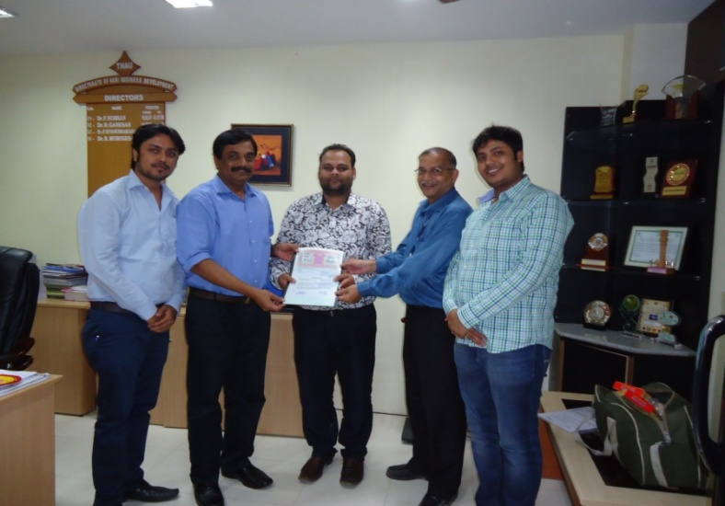
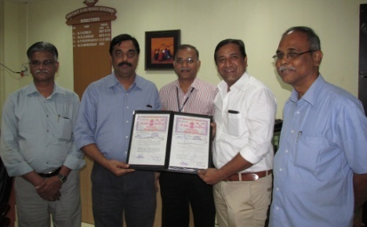
3.
M/s. Khusboo Enterprises (2014)
AZIZ Complex,
Panbazar,
Guwahati,
Assam, India
Email : ravi_agarwal8@yahoo.com
4.
M/s. BHUVI CARE (P) LTD. (2014)
Sipcot Industrial Growth Centre,
Gangaikondan,
Tirunelveli – 627 352.
Tamil Nadu, India.
Email : bcpl2002@gmail.com

Slide 20
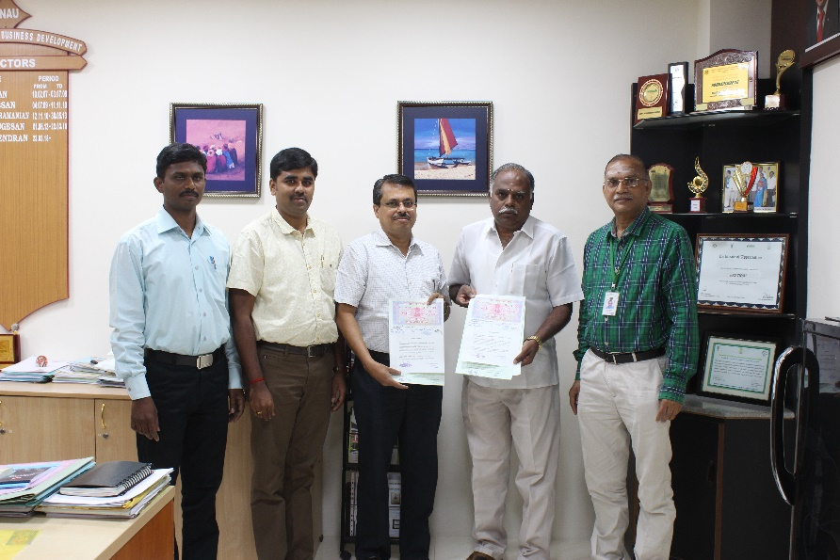
5.
M/s. Sri Vrintha Traders. (2019)
164/4, Basmathi Complex, Balaji Nagar
Sidhapudur, Coimbatore – 641044.
Tamil Nadu, India.
Phone : +91 9865464448, +91 422 2243989
Email : srivrinthatraders@gmail.com

Slide 21
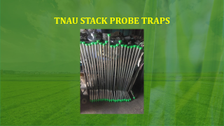
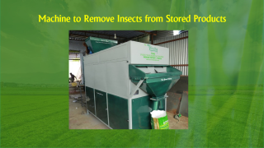
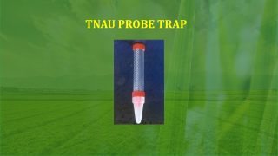
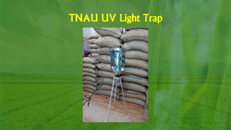
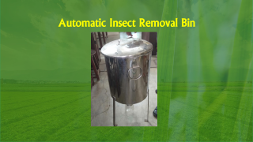
COMMERCIALISED TECHNOLOGIES

Slide 22
TNAU PROBE TRAP

Slide 23
TNAU PROBE TRAP
No Chemicals
No side Effects
No maintenance cost
Efficiency: TNAU Insect traps are excellent insect detection devices in food grains and more effective in the detection of stored grain insects namely Rhyzopertha dominica (F.), Sitophilus oryzae (L.) and Tribolium castaneum (Herbst) in stored food grains.

Slide 24
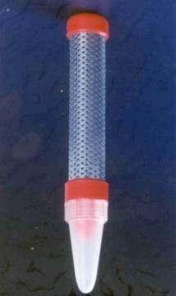
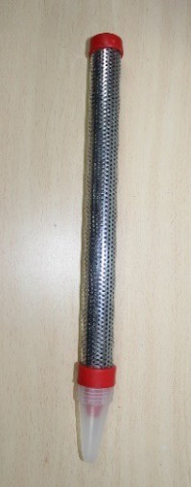
TNAU PROBE TRAP
Technology to detect insect presence at early stage in commodities
The use of trap is relatively a new method of detecting, trapping insects in stored grains.
The basic components of a TNAU probe trap consists of three important parts: A main tube, insect trapping tube and a detachable cone at the bottom.
Equispaced perforations of 2 mm diameter are made in the main tube.
Concept: Insects love “AIR” and move towards air. This behaviour of the insect is exploited in this technology.
Available Sizes : 6 inch, 12 inches
6 inch
12 inch

Slide 25
TNAU PROBE TRAP
How to Use :
The insect trap has to be kept in the grain like rice, wheat etc., vertically with the white plastic cone downside as shown the figure.
The top red cap must be with the level of the grain. Insects will move towards air in the main tube and enter through the hole.
Once the insect enters the hole it falls down into the detachable white cone at the bottom. Then there is no way to escape and the insects are trapped forever.
The white detachable cone can be unscrewed once in a week and the insects can be destroyed.

Slide 26

Commercialization of
TNAU PROBE TRAP
KSNM MARKETING (2002)
SF No.29/1B, Ona Palayam,
Siruvani Water Line Road,
Dheenam Palayam Post,
Coimbatore, Tamil Nadu - 641 109, India
Web : www.ksnmmarketing.com
Email : ksnmmarketing@hotmail.com
Though the product was developed in 1993, it was commercialized in 2002

Slide 27
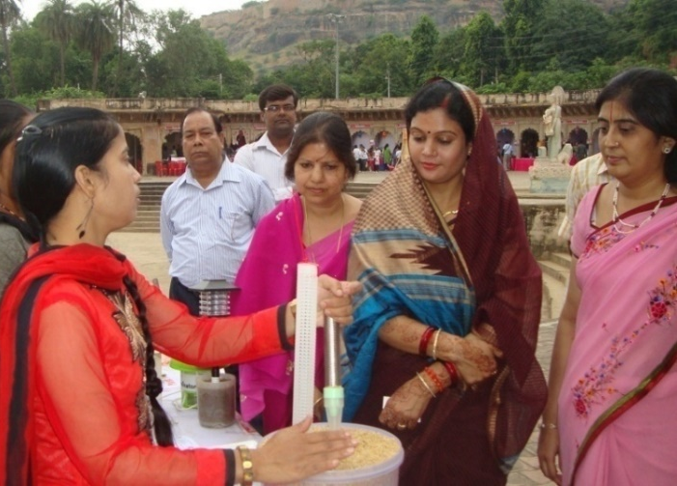
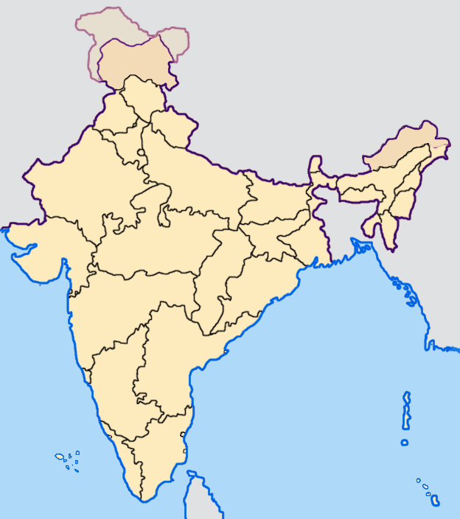
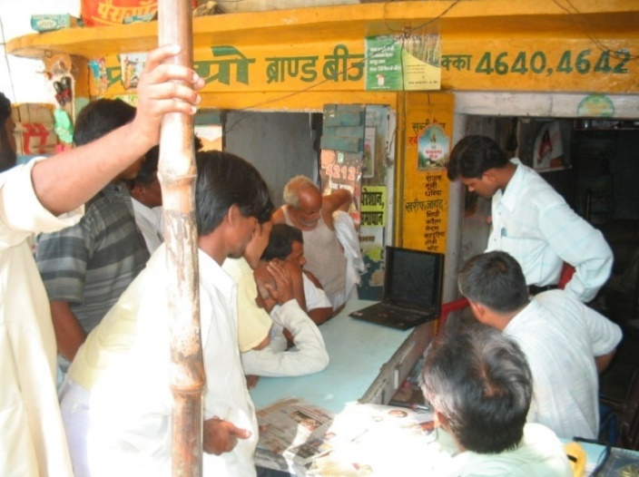
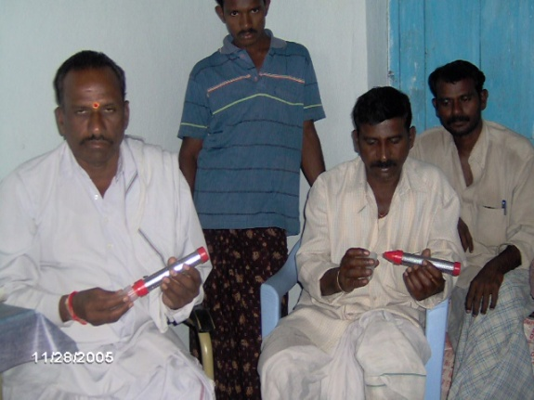


TNAU PROBE TRAP
USERS
500, 000
(0.5 million)
People are using the trap

Slide 28


TNAU PROBE TRAP
International Impact
TNAU- Trapping technologies have been introduced in other countries- Ethiopia, Rwanda, Nigeria, Egypt, Turkey and France.
Through training organized in India
Through Students
HATEGEKIMANA Athanase, M.Sc (Ag) – TNAU.
Currently working in Rwanda Agriculture Board (RAB)

Slide 29


School Students are Awarded for
Making their own Trap Model
TNAU PROBE TRAP
Kindling Scientific Temper among
School Children
If we are to teach real peace in this world, we shall have to begin with the children” -- Mahatma Gandhi
Besides being useful to the farmers, households and warehouse managers, my TNAU Insect trap technologies paved way for kindling scientific temper in school children.

Slide 30

TNAU PROBE TRAP
Kindling Scientific Temper among
School Children
Making
Cost-Effective
Pest Traps
by School
Students

Slide 31


TNAU PROBE TRAP
School Syllabus
Insect Probe trap has been included in the
Higher Secondary School Syllabus in Agricultural Subject

Slide 32







Awards for
TNAU PROBE TRAP
Technology
1993 TN
1994 ICAR
2002 GoI
2010 ICAR
2003 TN
2005 TNAU

Slide 33

TNAU PROBE TRAP
Recent Awards (2022)
1st Position in
Video Making Competition
(Video on the impact of probe trap on the creativity of school Children)
of Techneev@75 programme
on the occasion of
Azadi ka Amrit Mahotsav by
Ministry of Science & Technology, Ministry of Earth & Sciences and MyGov
2022

Slide 34


TNAU PROBE TRAP
Demo
You tube: https://youtu.be/exCu3Y3EZt8
You tube: https://youtu.be/piT0yiGnIyQ

Slide 35

TNAU STACK PROBE TRAPS

Slide 36
TNAU STACK PROBE TRAP
Indian Patent - 284727
TNAU STACK PROBE TRAPS
  This trap is a beautiful device which can be inserted in the interspaces between bags in a stack at any layer.
  Insert this stack probe trap in different layers of stack with more concentration -more numbers in the middle layer immediately after fumigation.
  Check the trapping tube for any insect presence. Sometimes you may get Larva of insect also. If there is insect, there is likely resistant insect population in the stack fumigated.

Slide 37



TNAU STACK PROBE TRAP
Indian Patent - 284727
TNAU STACK PROBE TRAPS
You tube link https://www.youtube.com/watch?v=ZkKno2GN12A

Slide 38
TNAU STACK PROBE TRAP
Indian Patent - 284727
TNAU STACK PROBE TRAPS
USERS :
More than 500 stack probe traps are being used by many Private Warehouses in India for different commodities in storage.
Through stack probe trap many stack holders are able to know the Insect population level in their stacks in warehouse. By this they are able to predict early presence of insects in their food grains stacks and also to validate the effect of fumigation by using it immediately after fumigation in different layers of the fumigated stack.

Slide 39


TNAU STACK PROBE TRAPS
Indian Patent No 284727
At present 500 units are being used in the detection of insects in warehouses in India …… I Hope and am always optimistic …… that every warehouse in India will have this tool … an essential tool to detect insects in warehouses which stores > 60 million tonnes of food grains for Public distribution system in our National Food Security Mission.
M/s Gubba Cold Storage, Secunderabad, India.
M/s Mahyco Maharashtra Hybrid Seeds Co. Ltd, India.
M/s Ulavan Producers Company, Erode, India.
- Commercial use of Stack Probe Traps in Turmeric warehouse.

Slide 40

Automatic Insect Removal Bin

Slide 41
Automatic Insect Removal Bin
Automatic insect removal bin (AIR)can remove insects automatically.
This bin exploits wandering behaviour of stored product insects as well as the movement of these insects towards well aerated regions.
This AIR bin will be useful for storing rice, wheat, broken pulses, coriander etc.

Slide 42
Automatic Insect Removal Bin
The insects such as rice weevil, lesser grain borer, red flour beetle, saw toothed beetle, which are commonly found attacking stored grains can be removed automatically by storing grains in this container.
Within a very short period of 10 days a majority of the insects (more than 90 per cent) can be removed from the grains. The containers are available in 2 kg, 5 kg, 25 kg, 100 kg

Slide 43

Publication
Resource, Engineering and Technology for a Sustainable World, American Society of Agricultural Engineers, Vol.7, No.9, September 2000,

Slide 44

Award for Insect Removal bin
Technology Day Invention Award by
Science and Technology, Government of India.

Slide 45

Automatic Insect Removal Bin - Users
25 kg capacity
500 kg capacity
100 kg capacity
YouTube Link : https://youtu.be/Iyruql0BSRM?si=ulwEYBXGVKD4IEwB

Slide 46

TNAU UV Light Trap

Slide 47
TNAU UV Light Trap
The UV light trap mainly consists of an ultra-violet source (4W/15W germicidal lamp). The lamp produces ultra-violet rays of peak emission around 250 nanometer.
The light trap attracts stored product insects of paddy like lesser grain borer, Rhyzopertha dominica, Paddy moth, Sitotroga cerealella, red flour beetle, Tribolium castaneum, Tenebrionids (meal worms / false fire worms, Warehouse moth (Ephestia sp.), Rice moth (Corcyra cephalonica), Indian Meal moth (Plodia sp.) and Gingelly Pod bug, Elasmolomus sp. in large numbers.

Slide 48
TNAU UV Light Trap
Precautions:
The control switch for the UV Light trap should be arranged outside the godown with danger mark (Skull & Bone in red). An indicator lamp may be set at the entrance of the godown indicating that UV light traps are ON so that workers can switch off the light traps and entre the godown.
Close the operational area completely when UV Lights are ON.
Avoid operation of UV light trap in the days when air charging with insecticides is being done.

Slide 49
TNAU UV Light Trap
General precautions like avoiding viewing the UV light closely should be followed.
The labourers / staffs of the warehouses should be educated on the above precautionary measures.
Switch off the trap device before taking observations and wear lab coat and long pants. Use UV absorbing glass or plastic shields to protect from UV rays.

Slide 50
TNAU UV Light Trap
USERS
  Food Corporation of India/TN warehouse Corporation procured more than 1000 UV-LIGHT traps for use in rice and wheat storage.

Slide 51



TNAU UV Light Trap
(Updated Model)
https://youtu.be/tc1J2JUX1Cc

Slide 52

Machine to Remove Insects from Stored Products

Slide 53

Machine to Remove Insects from Stored Products
Patent By : Sri Vrintha Traders
Application Number : 202341056537
Application Date : 20/08/2023
Inventors : S. Mohan and Balaaji. M

Slide 54
Commercialization
Machine to Remove Insects from Stored Products
Impact - 2019 to 2022
SPECIAL FEATURES:
  100/- chemical free technology
  The device is useful in removing adult insects besides eggs, larvae and pupae of free living insects
  This helps in arresting further build up of insect during storage of grain
  No wastage of grains.
  Shelf life of grains increased
  Highly suitable for Miller's, traders besides exporters.
  Capacity one to two ton per hour power saver model
  End-users : Millers, Traders, Farmers Self Help Group in India, Dubai, Oman, Qatar, Saudi Arabia, Philippines and Malaysia.
You tube link : https://youtu.be/yh6y9R7VjFU

Slide 55


Award - 2023

Slide 56


TNAU- KIT USERS
300 Agricultural Colleges and farmers training centers across the country are using the KIT

Slide 57
My Journey Continues . . . .

