Slide 1
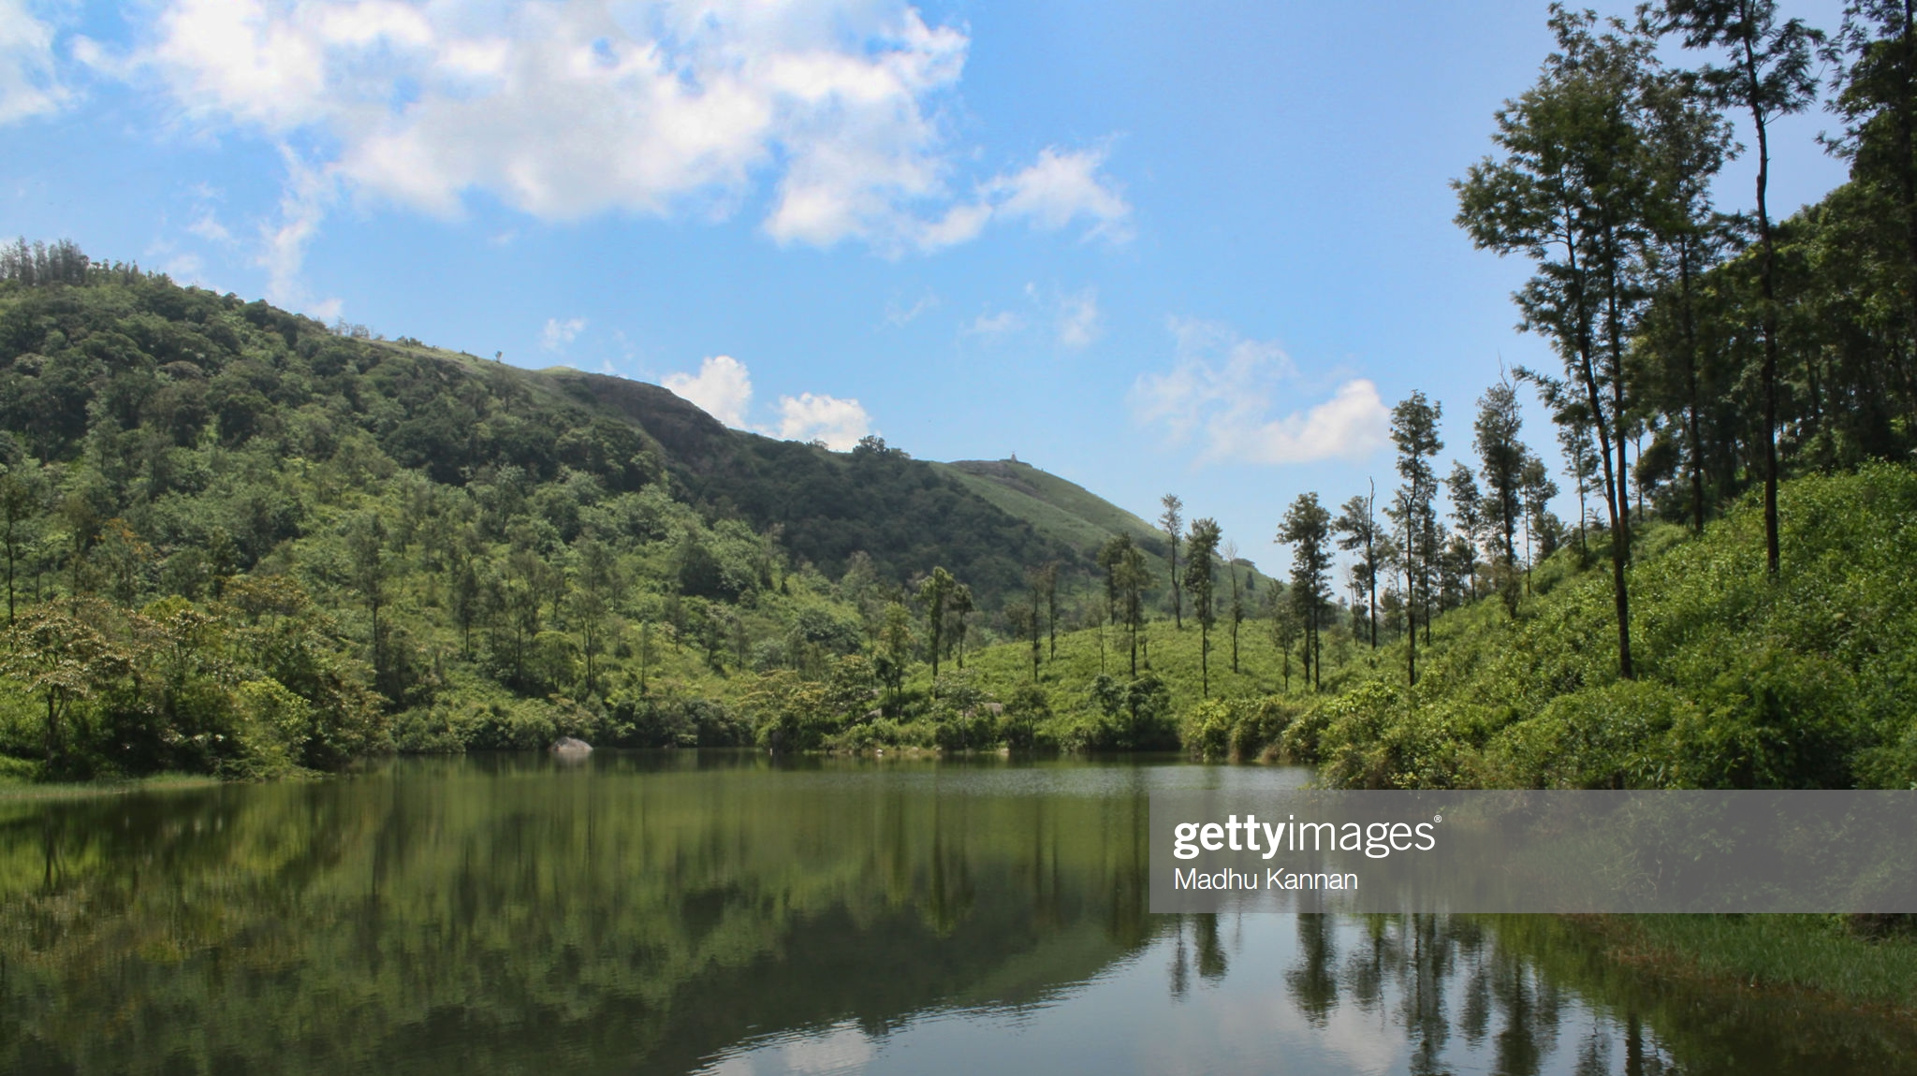
Bio Management of Cardamom Plantation
Dr.S.Easwaramoorthy

Slide 2
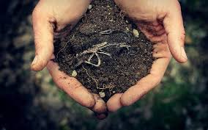
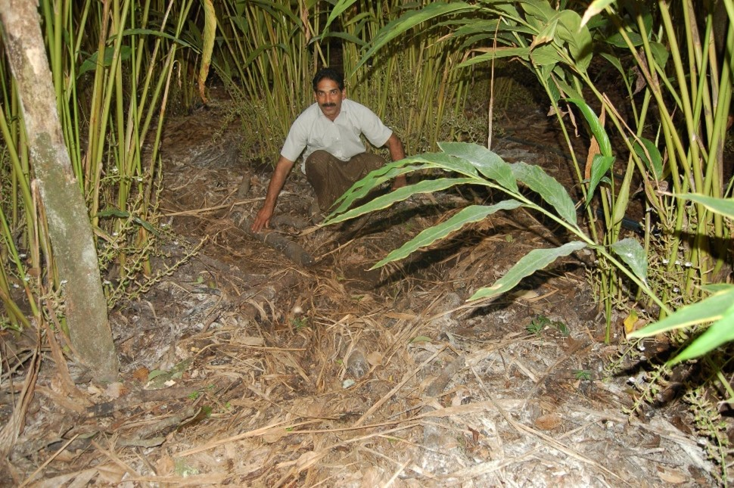
Soil Management
Improving organic matter content
Mulching

Slide 4
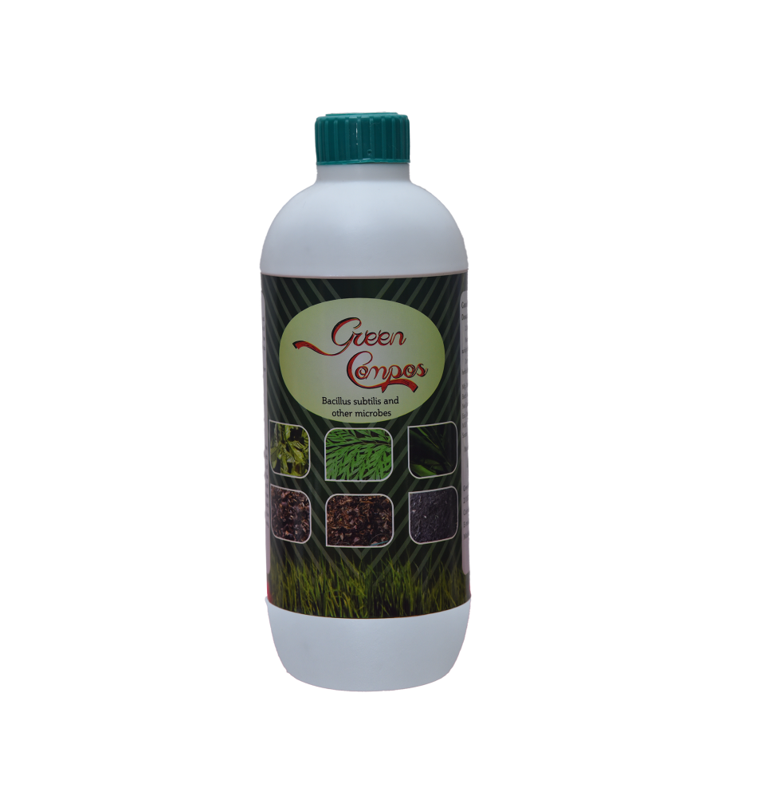
Compost making and enriching the soil
Make compost by yourself.
Spread Farmyard manure or any farm waste as a heap @ 4 feet width and 3 feet height under shade.
Add 500 ml of Green compos containing cellulolytic and lignolytic fungi, bacteria and actinomycetes per tonne.
Rock phosphate should be incorporated at 1% level to narrow down crude protein ratio of substrate.
Cover the top with mulch. Keep the compost heap moist.
Within 45-60 days the height of compost heap comes down to about 1.5 feet and the compost is ready for application to the plant.
Nitrogen content of compost prepared in this way with rock phosphate is 2 times that of normal compost.

Slide 5
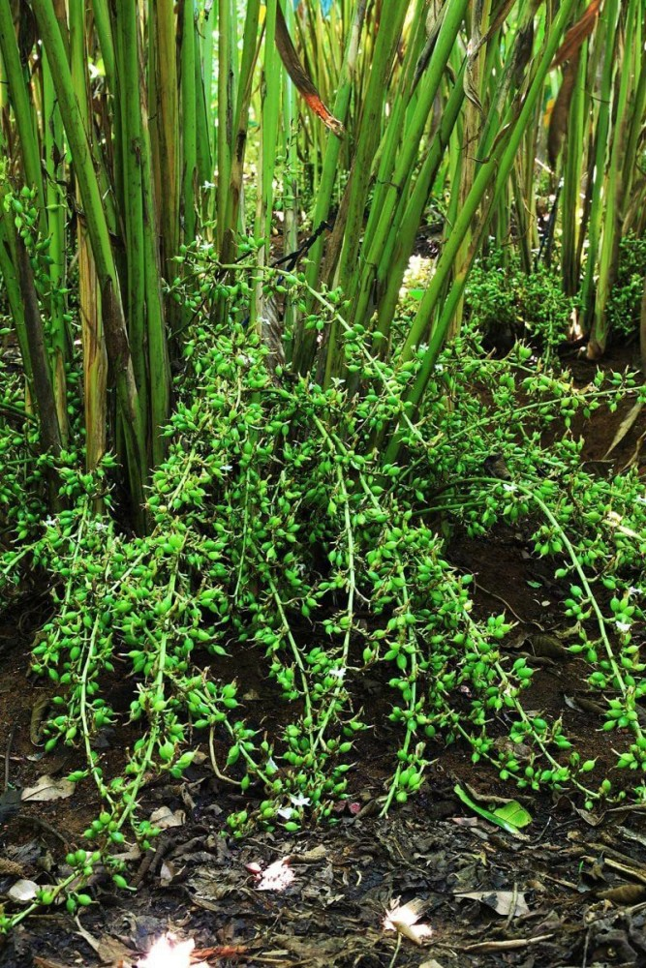
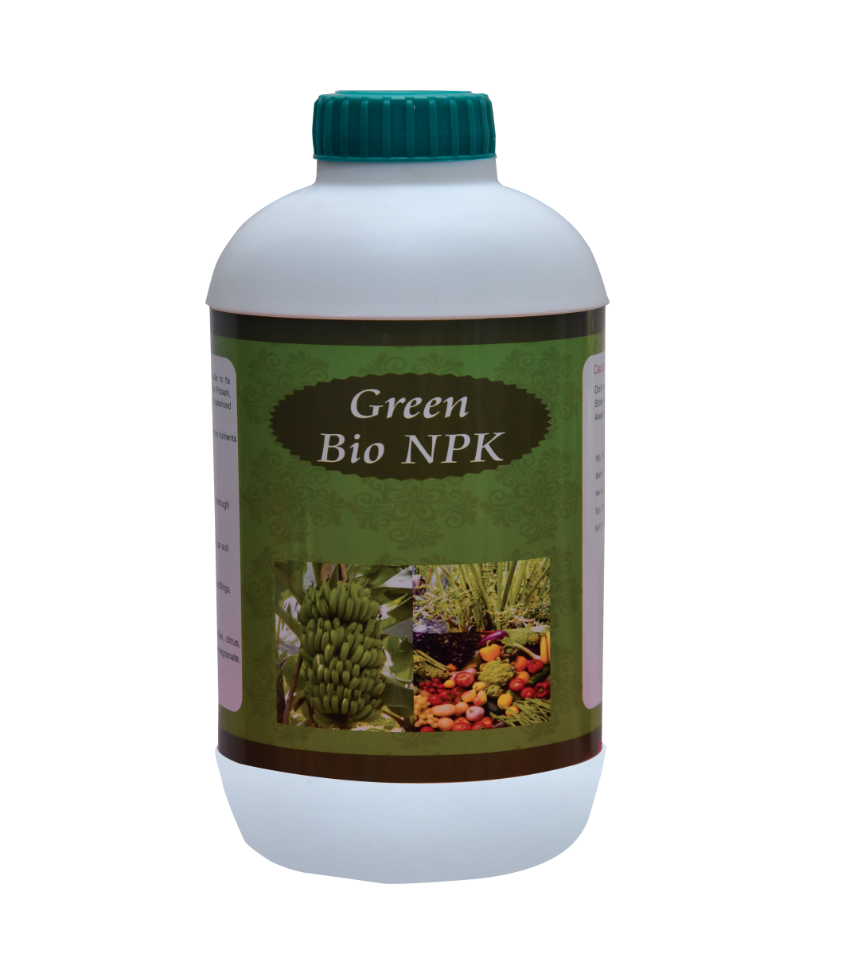
Bio NPK
Apart from one or two application of recommended dose of chemical NPK in soil (which can be applied in Aug and Oct) Bio NPK can be applied during April and November. Dosage : 500 ml of Bio NPK per 200 litres of water (one barrel)
Bio NPK Composition
Nitrogn
Azospirillum brasilense
Phosphorus
Aspergillus awamori
Potash
Frateuria aurantia
Zinc
Bacillus subtilis

Slide 6
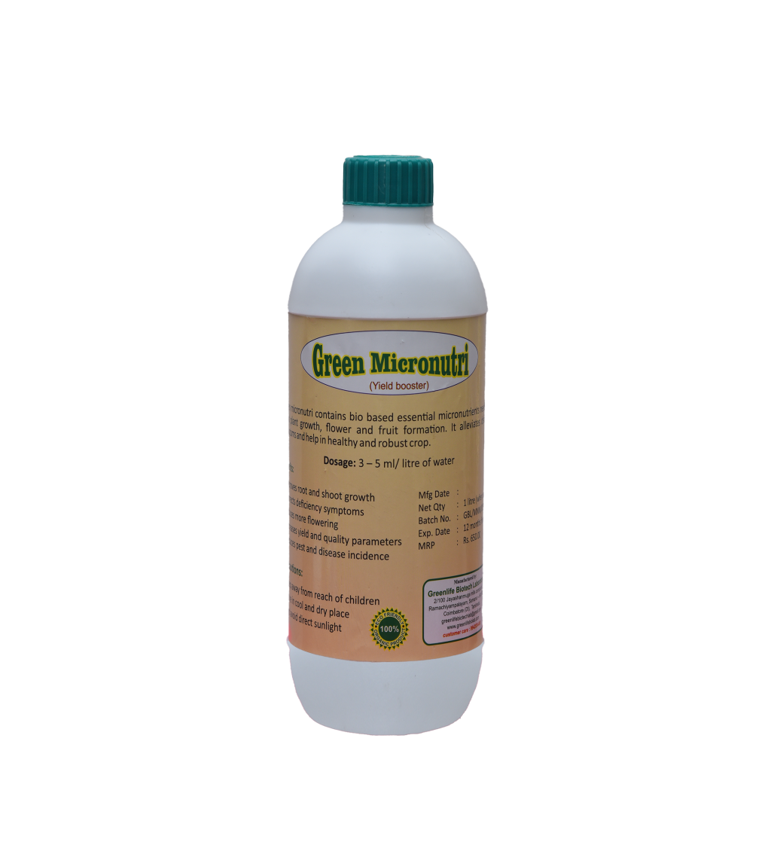
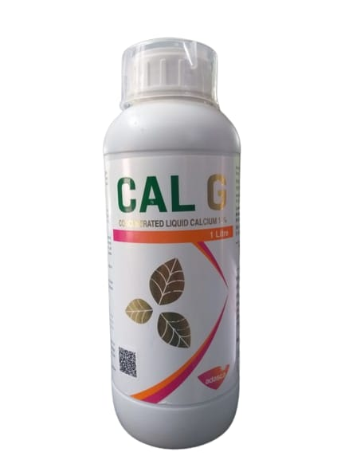
Bio & Nano secondary and micronutrients
Foliar spray of secondary and micronutrients can be done once in April and second time in August.
These bio micronutrients and secondary nutrients combination shall be on leaf only if chemical micronutrients and secondary nutrients are not sprayed.
Micronutrients composition
Iron 4.0 %
Zinc 1.2 %
Boron 0.6 %
Magnesium 0.5 %
Manganese 1.2 %
Molybdenum 0.1 %
Copper 1.0 %

Slide 7
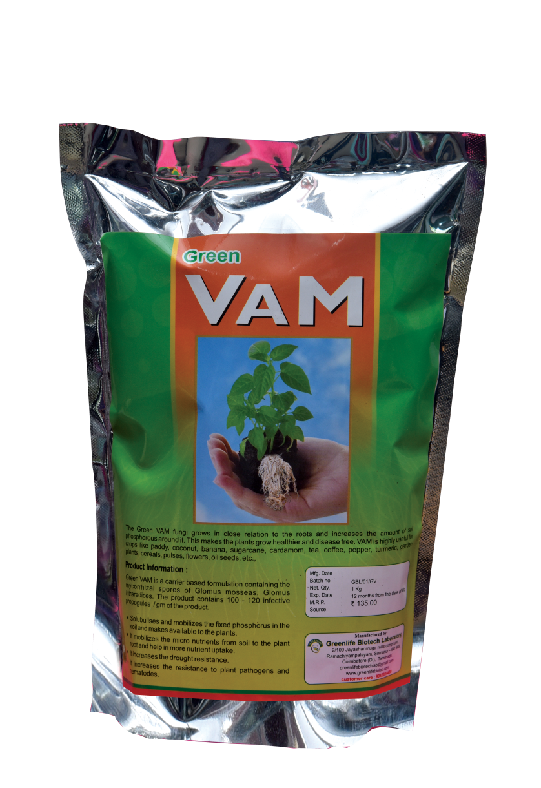
[VAM] Vesicular Arbuscular Mycorrhiza
⋆ VAM can be applied for better root growth and nutrient absorption during April and November.
⋆ Do not apply VAM if available soil phosphorous is high or if rock phosphate is applied in the soil.
⋆ VAM will be effective only applied alone when soil phosphorous is very low .
⋆ It makes available the micronutrients and helps the plant in more nutrient uptake.
⋆ It increases the uptake of secondary nutrients.
⋆ Recommendation : 50-100 gram per plant.

Slide 8
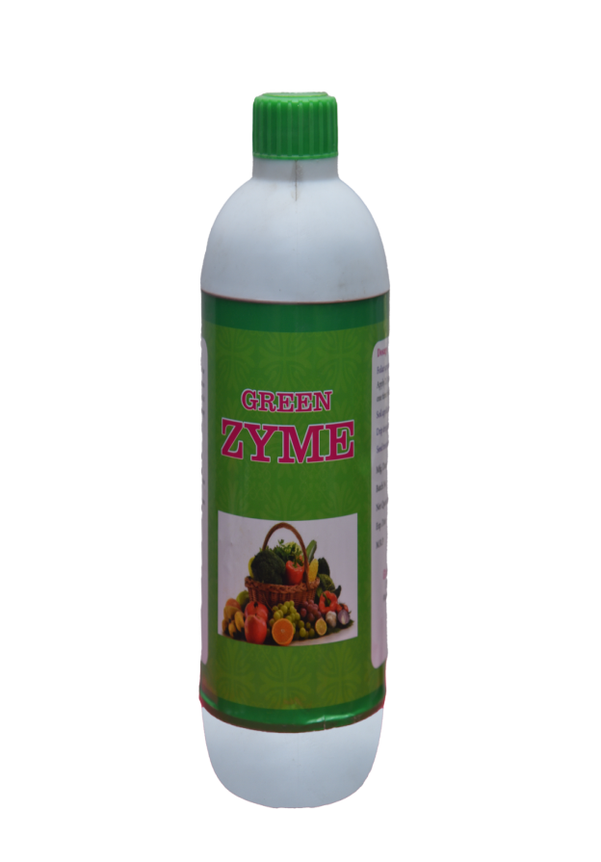
Plant growth enhancers
Green Zyme
It is a seaweed derivative.
It enhances the rate of photosynthesis and promotes faster growth of plants.
It lengthens the flowering season and improves fruit size and quality.
Soil application 4 to 8 litre per acre ( 1 to 2 litre per barrel – 200 litres )

Slide 9
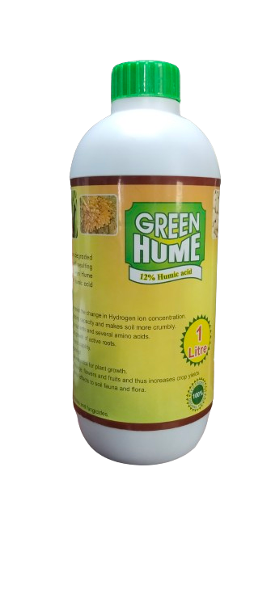
Green Hume
Available at a concentration of 12% humic acid.
Application of Green hume results in rapid growth of active roots.
It is rich in organic and mineral substances essential for plant growth.
It buffers the soil pH and has the ability to resist the change in hydrogen ion concentration.
Soil application 4 to 8 litre per acre ( 1 to 2 litre per barrel – 200 litres )

Slide 10
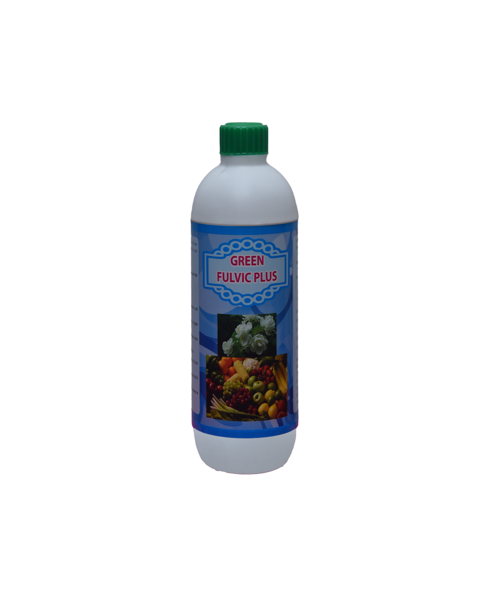
Green Fulvic Acid
As a foliar spray, fulvic acid increases the plant’s oxygen uptake capacity.
It is a powerful organic electrolyte and it enhances cell division.
It has a unique capacity to dissolve minerals and trace elements.
It can interact with sunlight to enhance photosynthesis.
Fulvic acid offers drought protection and detoxify pollutants in the soil.
Fulvic acid dissolves silica and responsible for increase in stomatal opening and assists plant respiration.
It stimulates the plant’s immune system.
Soil application 4 to 8 litre per acre ( 1 to 2 litre per barrel – 200 litres )

Slide 11
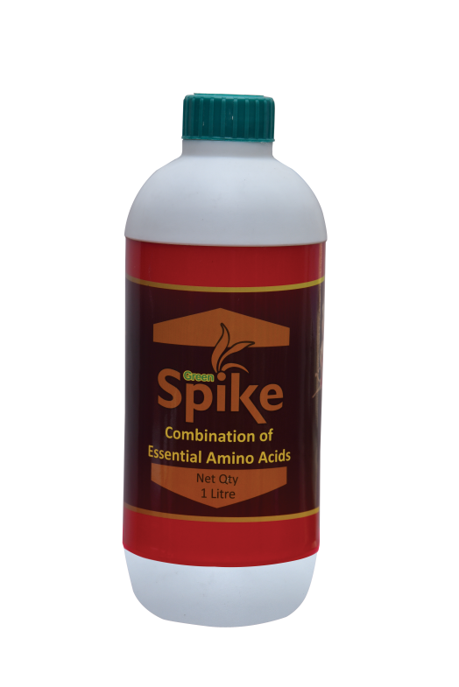
Green Spike
Contains 20% essential amino acids.
It improves photosynthesis and vegetative growth in plants.
It increases flowering, fruit set and yield.
Compatible with all pesticides & fungicides.
Soil application 4 to 8 litre per acre ( 1 to 2 litre per barrel – 200 litres )

Slide 12
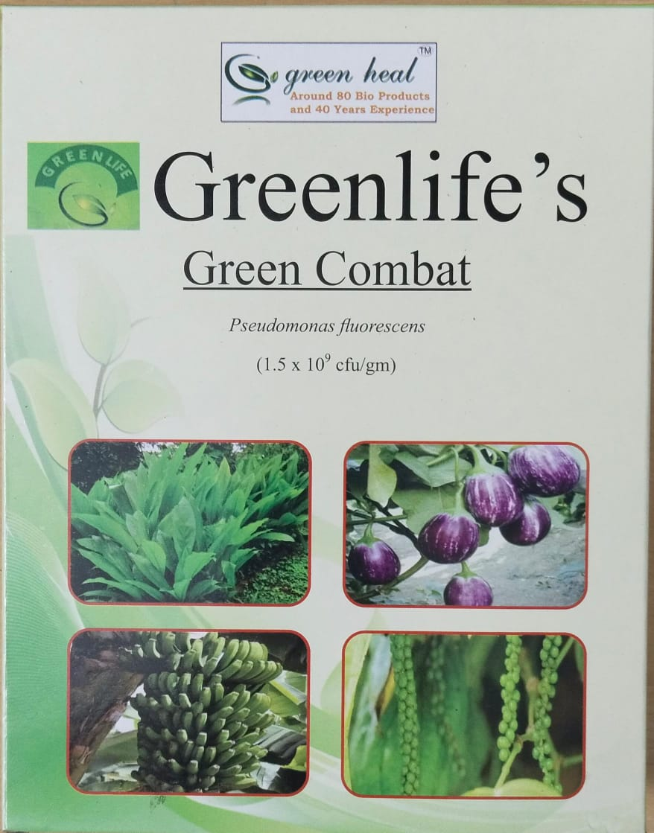
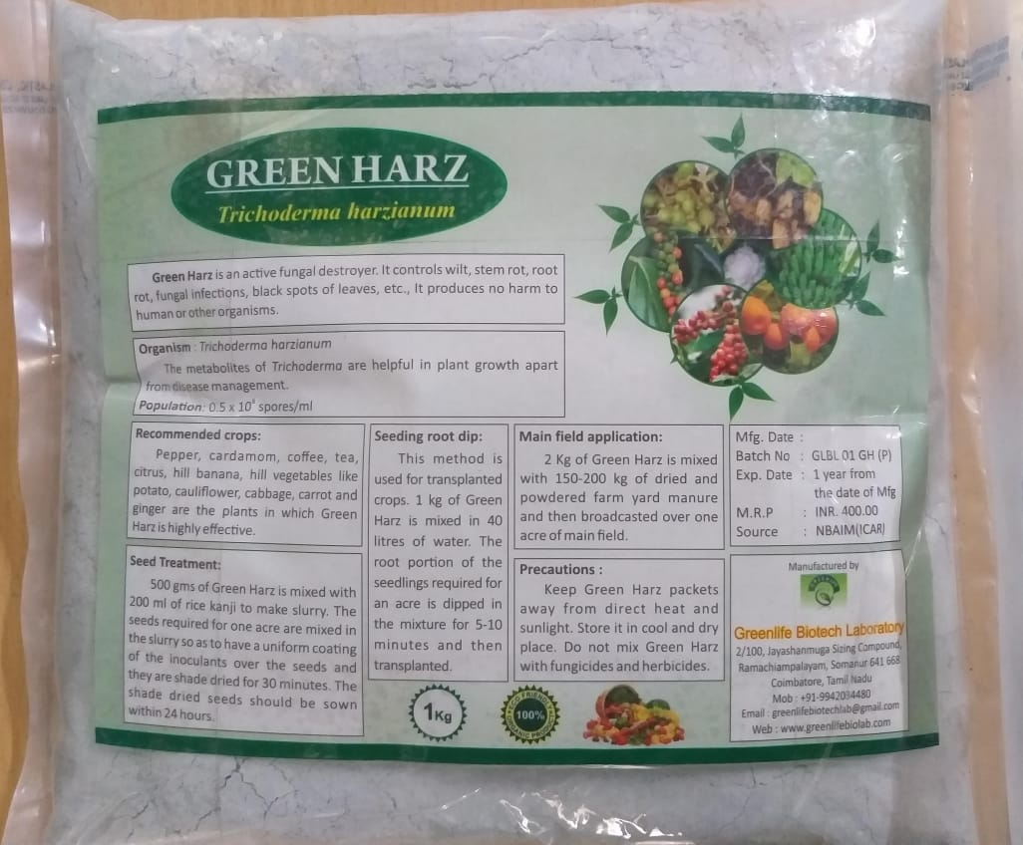
Bio management of Fungal diseases in Cardamom
Soil application with talc formulation of Pseudomonas fluorescens (Green Combat), Trichoderma harzianum (Green Harz), Bacillus subtillis (Green Dual).

Slide 13
Bio management of Fungal diseases in Cardamom
During April and November, application of compost (1-2 kg or more) along with talc formulation of Trichoderma harzianum + Pseudomonas fluorescens + Bacillus subtilis 100 g+ application of Neem cake 300-500g + bone meal 300-500g per plant in soil around the plant over the mulch after receiving at least 1” summer rain in April/after cessation of N.E.monsoon in Nov-Dec

Slide 14
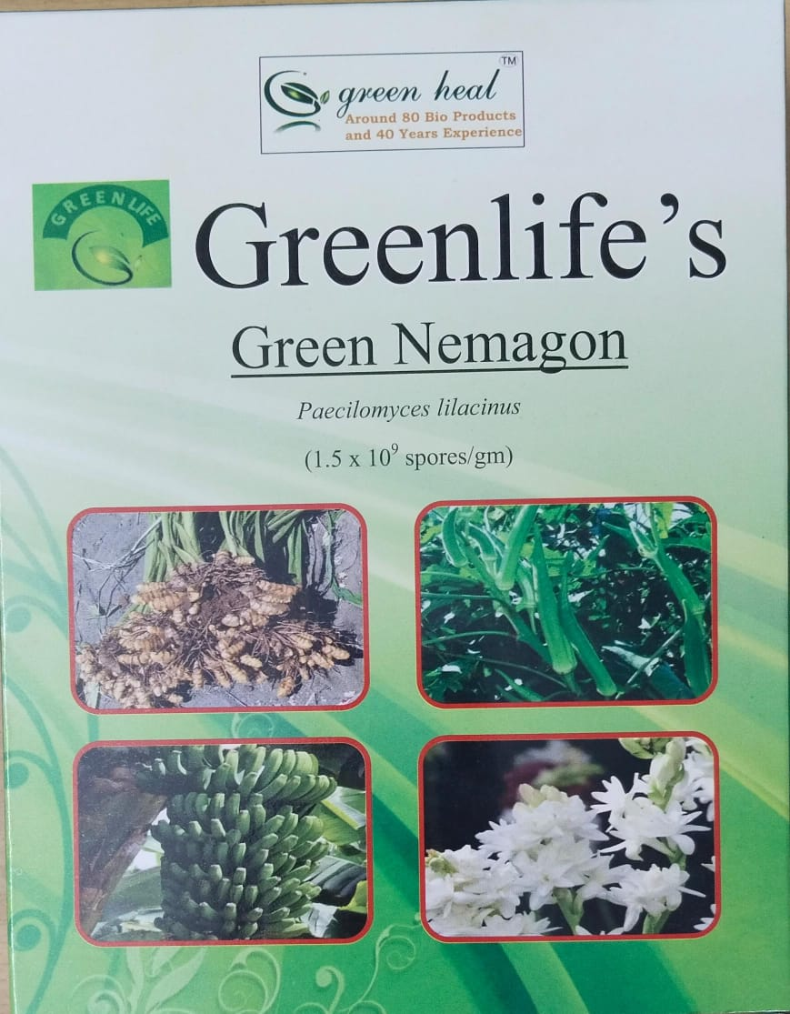
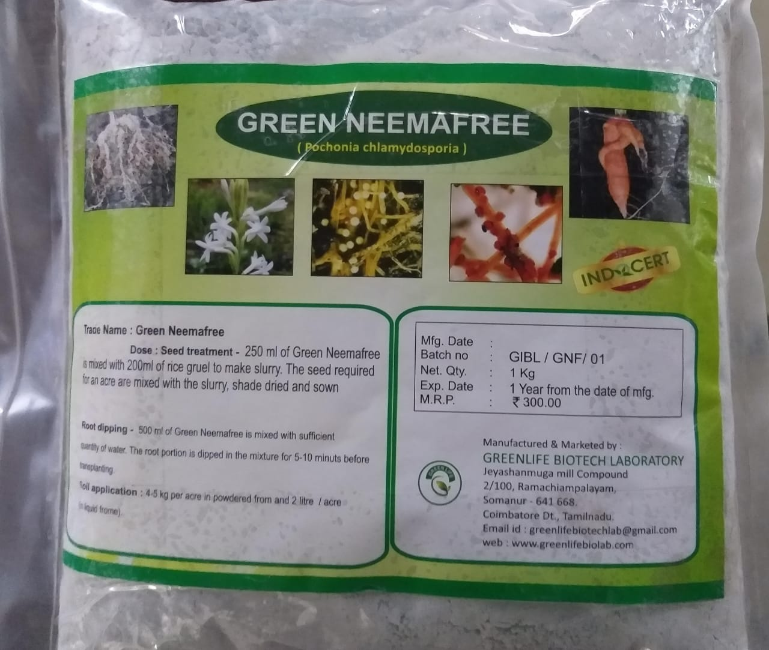
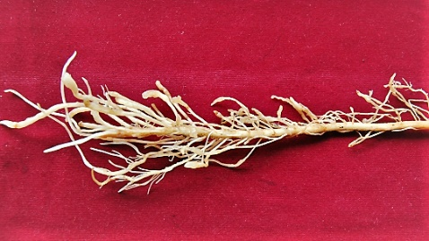
Soil nematode management
Soil application with talc formulation of Paecilomyces lilacinus (Green Nemagon)and Pochonia chlamydosporia (Green Neemafree).

Slide 15
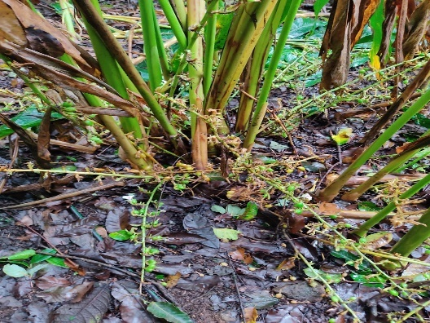
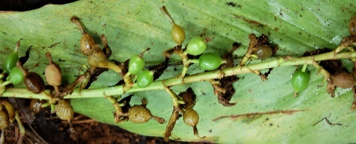
Liquid bio pesticides for soil application to manage fungal infection and nematode infestation
If the farmers wish to add bio pesticides for fungal disease control the following can be added either directly in the soil or through fertigation.
Pseudomonas fluorescens (Green Combat), Trichoderma harzianum (Green Harz ) and Bacillus subtillis (Green Dual) for fungal diseases.
Paecilomyces lilacinus (Nemagon) and Pochonia chlamydosporia (Green Neemafree) for root knot nematode control.

Slide 16
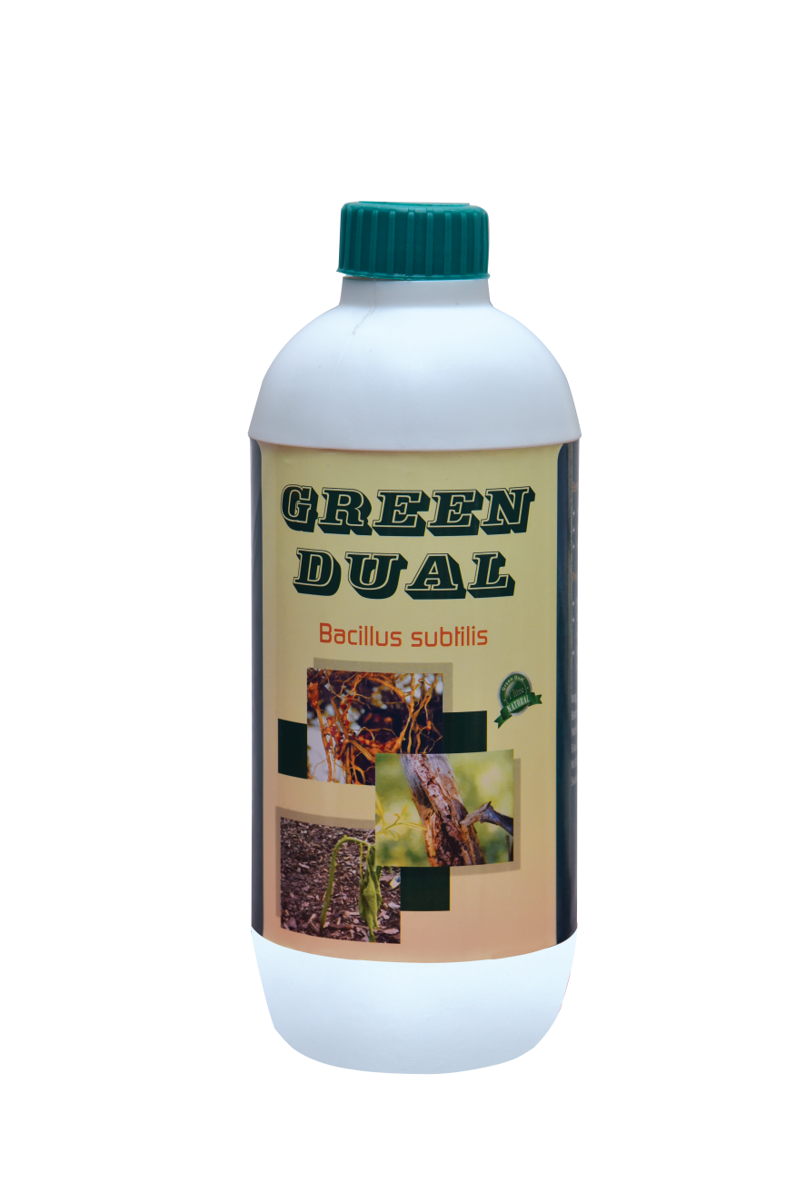
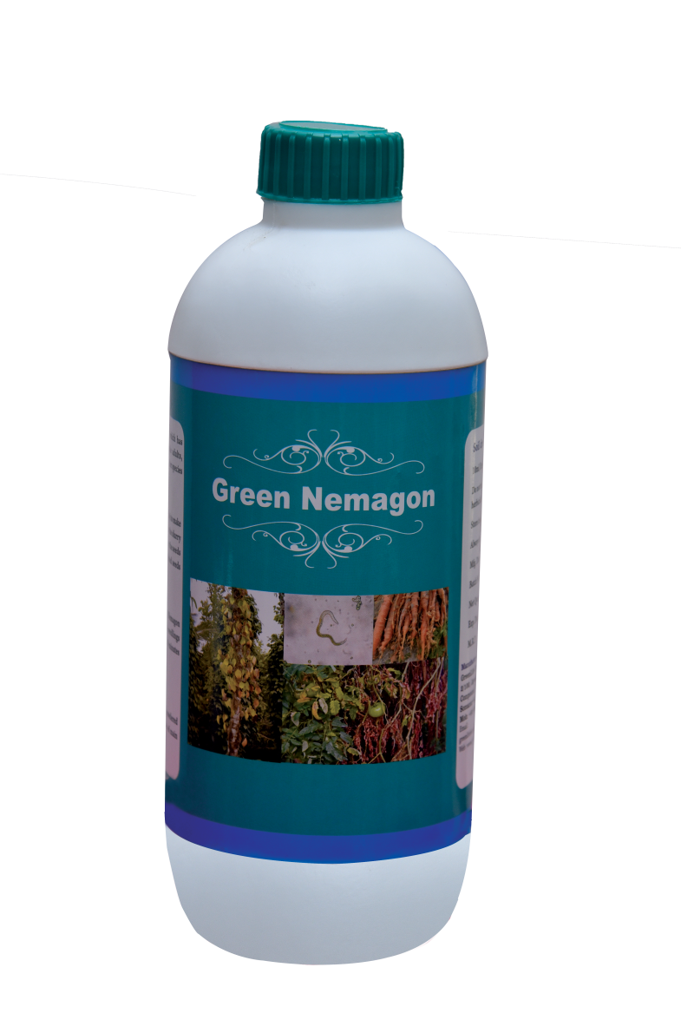
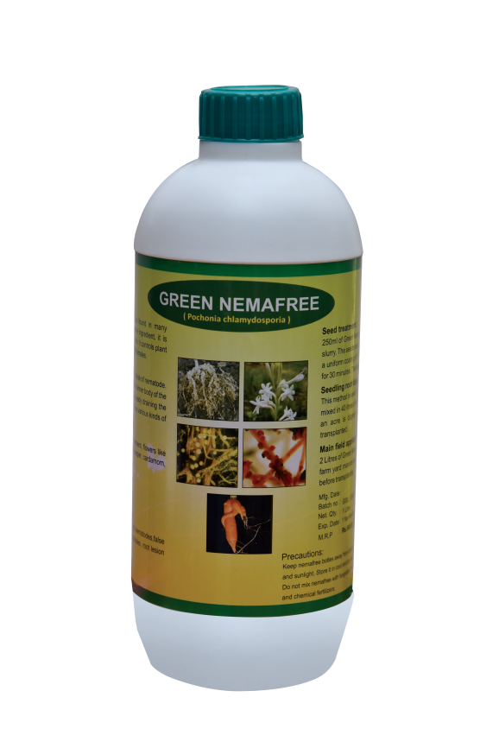
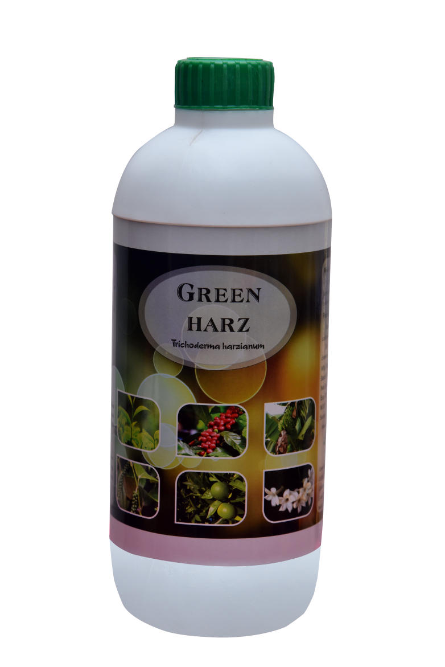
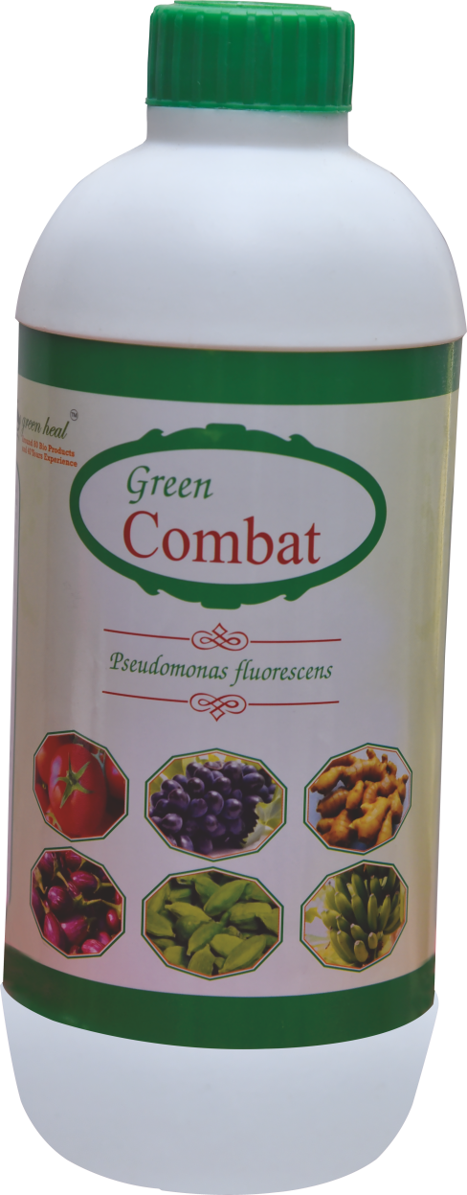

Slide 17
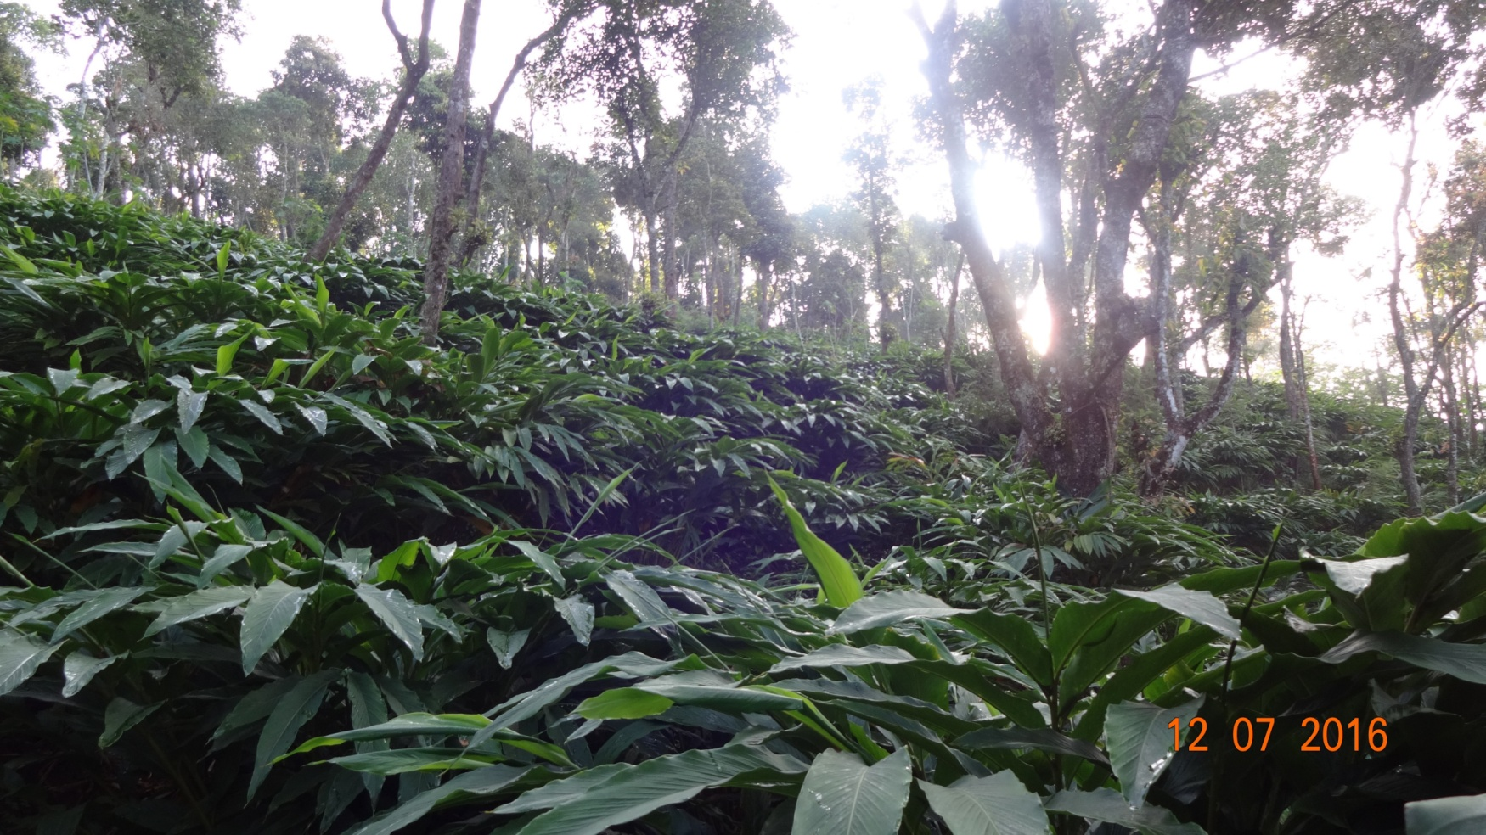
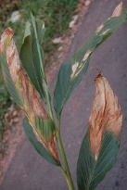
Foliar spray of Potassium Phosphonate
For enhancing cardamom plant resistant to fungal diseases, potassium phosphonate at the rate of 300 ml per 100 litres of water may be sprayed on the leaf thrice in a year namely April, September and December.
Leaf blight

Slide 18
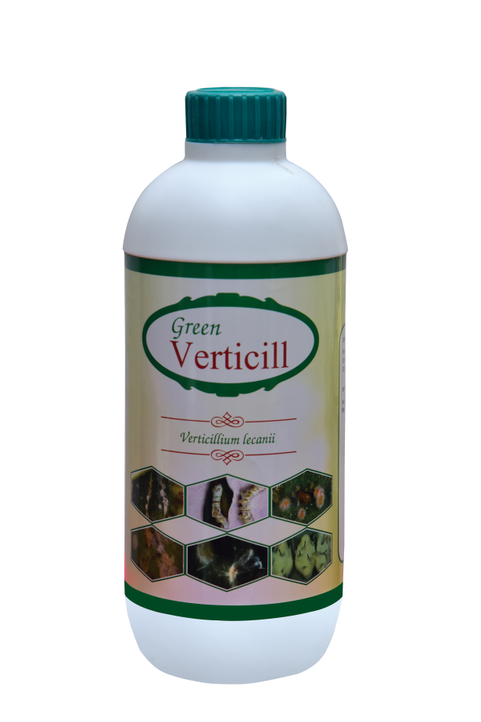
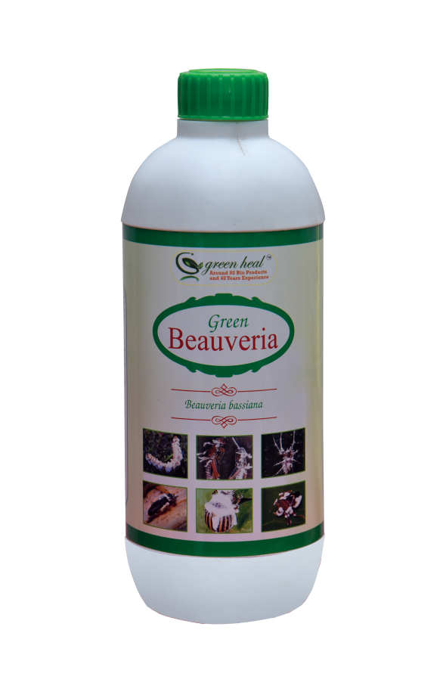
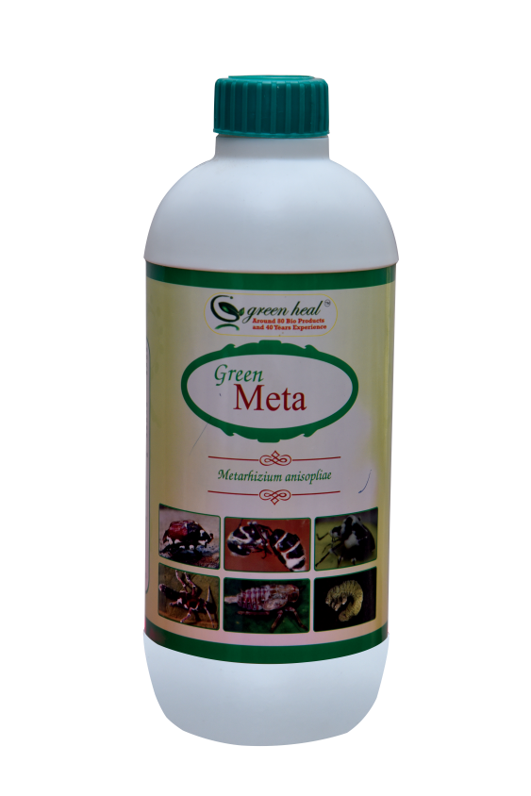
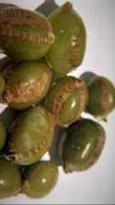
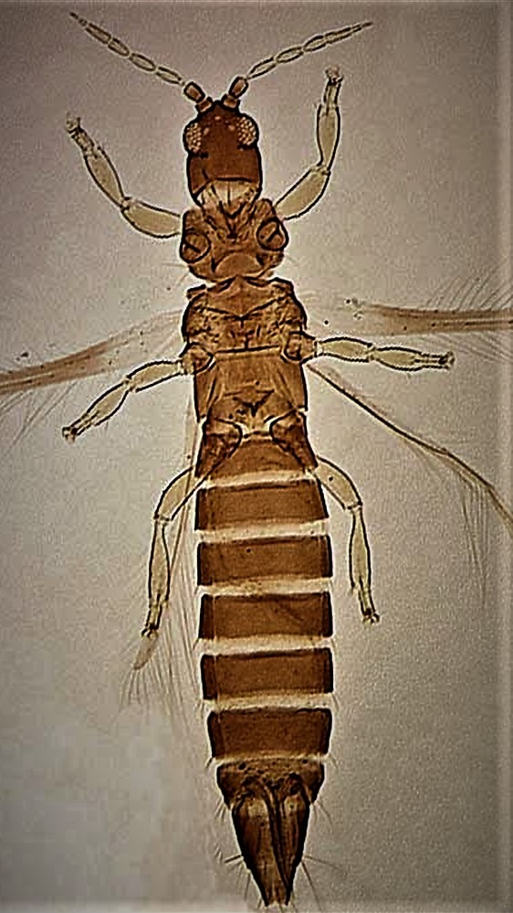
Liquid bio pesticides for foliar pest
Management of Thrips
Foliar spraying of Beaveria bassiana, Metarhizium anisopliae and Verticilum lecanii combination during summer month from Feb to May at the rate of 5 to 10 ml per litre once in 30 days (1 to 2 litres per barrel of 200 litres ).
This combination of biopesticide can also be mixed with chemical insecticides also Quinalphos @ 200ml and Profenofos @ 100 to 200 ml/200 litres of water.

Slide 19

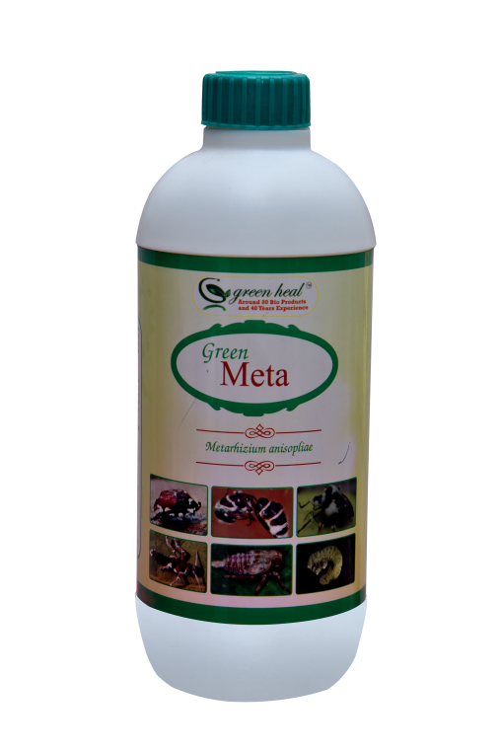
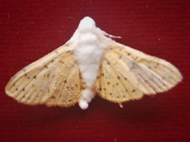
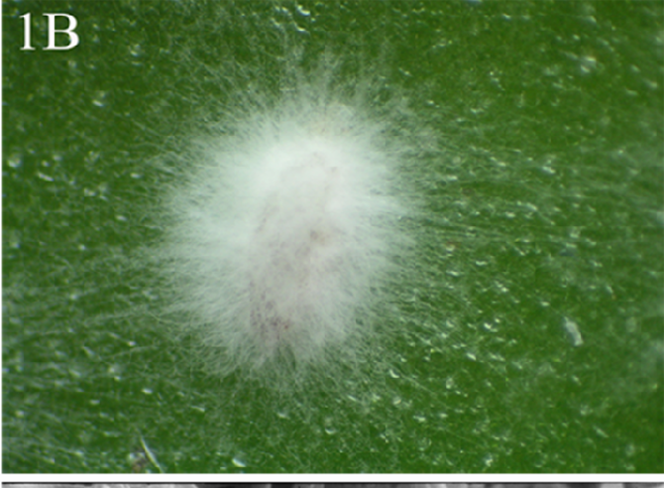
Borer & Whitefly management
Foliar spray of Beauveria bassiana and Metarhizium anisopliae combination @ of 5 to 10 ml per litre once in 30 days (1 to 2 littres per barrel of 200 littres ) for cardamom borer larva and moth control and whitefly nymph and adult control
This combination of biopesticide can also be mixed with chemical insecticides, Quinalphos @ 200ml and Profenofos @ 100 to 200 ml/200 litres of water.
Borer moth infested/killed by Beauveria
Whitefly nymph killed by Verticillium

Slide 20
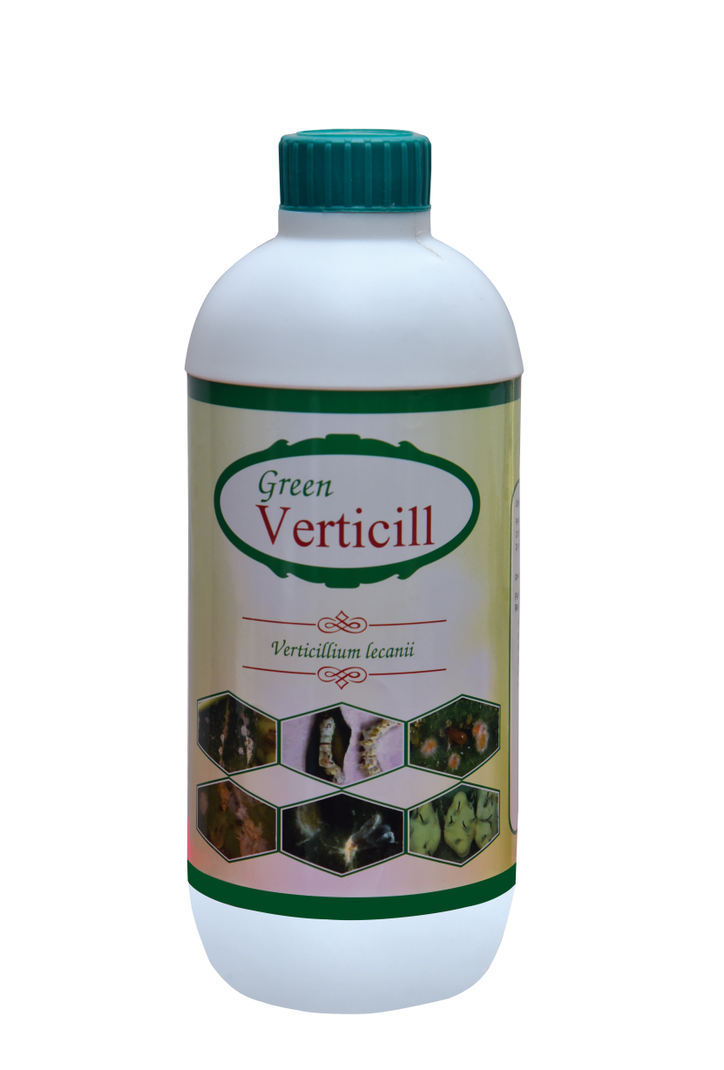
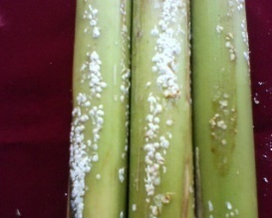
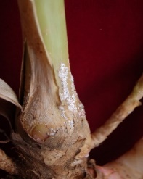
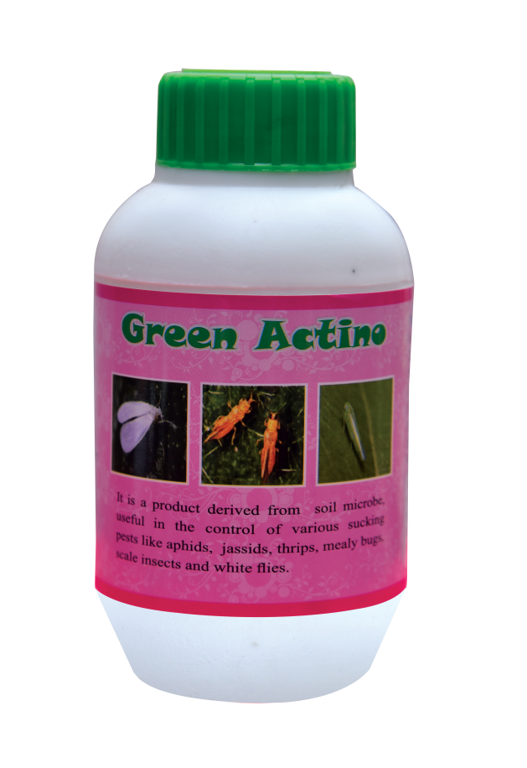
Management of root infesting mealy bug and stem infesting scale insect
Can be managed with spary of Verticilum lecanii 2 litres + Actino 300 ml per 200 litres of water .

Slide 21
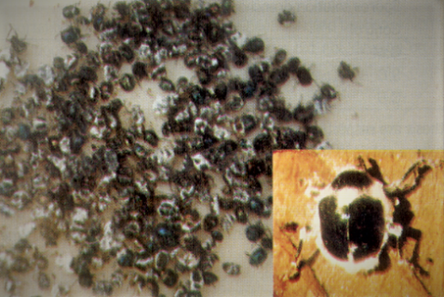
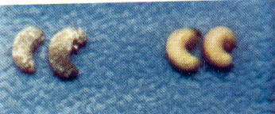
Root grub beetles infected by Beauveria and
the Grubs infected by Metarhizium
White grub
Root grub adult beetle

Slide 22
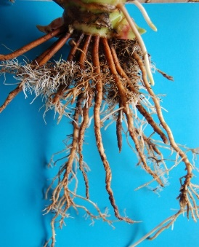
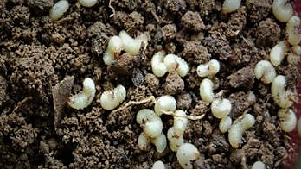
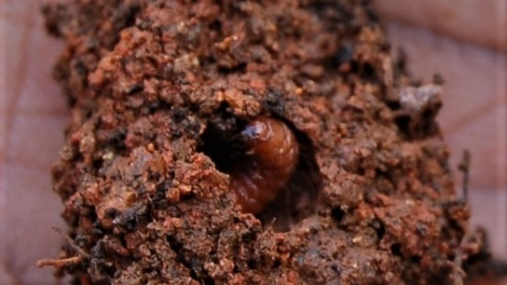
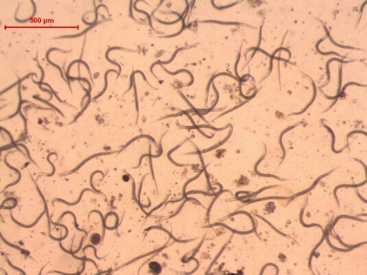
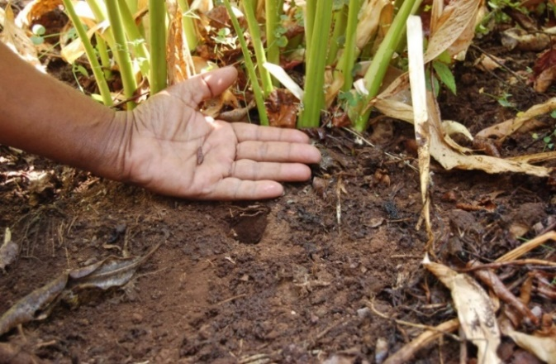
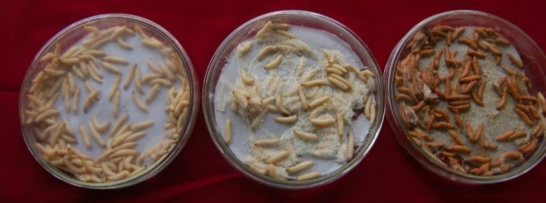
EPN for management of root grubs

Slide 23
Information about GREENLIFE BIOTECH LABORATORY
All the bio pesticides and fertilizers are prepare by Greenlife biotech laboratory are supplied as fresh material with high spore count. Supply will take 10 to 15 days after getting the farmer requirement. EPN can be supplied on advance booking either in April and August .
Certification agencies for our bio products
Certified by INDOCERT , Aluva, Kerala.
Competitive rate for all bioagents
All our products are much cheaper than IPL Biologicals limited, T.Stanes and company limites and Netsurf etc...
Our Bio products are exported to United Kingdom, Egypt, British Gayana, Rwanda.

Slide 24
THANKING YOU

Slide 25
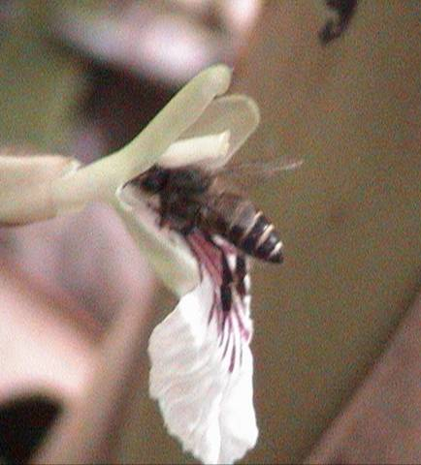
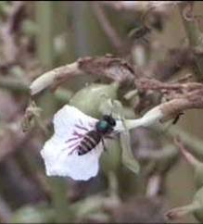
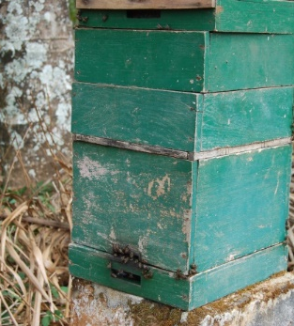
Honey bee the major pollinator on cardamom
Left: Rock bee Middle Indian honey bee Right: Bee-hive inside cardamom plantation

Slide 26



Slide 27







Natural Enemies of Cardamom Pests

Slide 28






Natural enemies of borer pest

Slide 29



Borer larva inside capsule (completely eating seeds inside) is parasitized by a tiny wasp like parasitoid

Slide 30





FUNGAL DISEASES
Azhugal by Phytophthora
Clump rot by Pythium/Rhizoctonia or Fusarium

Slide 31

Clump rot due to excess soil application at plant base and excess irrigation

Slide 32

Walk out due to Clump rot and Azhugal Excess irrigation resulting in excess moisture at plant base leading to clump rot

Slide 33

TOP: Panicle damaged by Borer
BOTTOM: Panicle damaged by Fusarium (Panicle Blight)

Slide 34

Fungal diseases of cardamom
Leaf shredding due to leaf rot caused by Phtopthora

Slide 35


LEFT: Leaf Blotch during rainy season (Casued by Phytopthora)
RIGHT: Leaf Blight during winter season (December & January) (Caused by Phytopthora)

Slide 36

Tiller break due to stem rot(Fusarium)
/Borer damage

Slide 37

Katte virus affected Cardamom leaf

Slide 38


Slide 39

Thank you
Thank you

